Slide 1
What Climate Emergency?
Charles Battig, M.S., M.D. www.climateis.com
CO2 Coalition
Heartland Institute
A Self Guide Based On Hard Evidence With Commentary
May2, 2021

Slide 2
What is Climate?
By convention, climate is weather averaged over a 30 year period.
What determines the weather? How is it measured?
Atmospheric temperature, sea temperature, sea currents, barometric pressure and pressure gradients, relative humidity, land mass contours, vegetation, atmospheric dust particles, ambient solar energy, incoming cosmic particles, volcanic activity, surface absorption and reflection of solar radiation, cloud cover, temperature differentials between the poles and the tropic equatorial regions, the jet stream, the solar wind, and green house gases are many, but not all the factors, interacting to produce the weather of the day.

Slide 3
A Non-Existent Existential Threat
Climate change is real…it has been the norm since the beginning of Earth’s formation
There is no ideal equilibrium state for the climate, it is in constant flux
There is no single “perfect” global temperature
Climate change exists in many forms…most without known causation. We have explanations for the changing of the seasons in the changes of the tilt of the Earth’s axis and elliptical orbit a around the sun, but no explanation for the end of the last major ice age around 10,000 years ago, though the Milankovitch Cycles are postulated.
Climate change is the result of a multitude of factors, some known, many unknown.
Historically climate change impacts on human survival have been met by human adaptation.

Slide 4
Monthly Weather Review for November 1922
“Nothing New Under The Sun”
The Arctic ocean is warming up, icebergs are growing scarcer and in some places the seals are finding the water too hot, according to a report to the Commerce Department yesterday from Consul, at Bergen, Norway.
Reports from fishermen, seal hunters and explorers, he declared, all point to a radical change in climate conditions and hitherto unheard-of temperatures in the Arctic zone. Exploration expeditions report that scarcely any ice has been met with as far north as 81 degrees 29 minutes. Soundings to a depth of 3,100 meters showed the gulf stream still very warm.
Great masses of ice have been replaced by moraines of earth and stones, the report continued, while at many points well known glaciers have entirely disappeared. Very few seals and no white fish are found in the eastern Arctic, while vast shoals of herring and smelts, which have never before ventured so far north, are being encountered in the old seal fishing grounds.

Slide 5
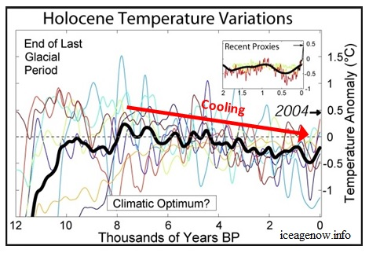
Fear Is The Effective Tool For Political Control
Political Propaganda
Scientific Reality
Global Cooling/New Ice Age
Global Warming
Climate Craziness
Climate Change
Climate Chaos
Climate Collapse
Climate Anxiety
Climate Emergency
Global Meltdown
Existential Threat
World War Zero

Slide 6
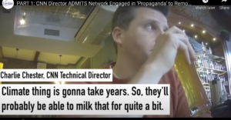
Slippery Slope of Climate Propaganda Fearmongering, Wordsmithing, And Media Mendacity
Global Warming
Climate Change
Carbon Dioxide Pollution
Carbon Pollution
Existential Threat/Climate Emergency

Slide 7
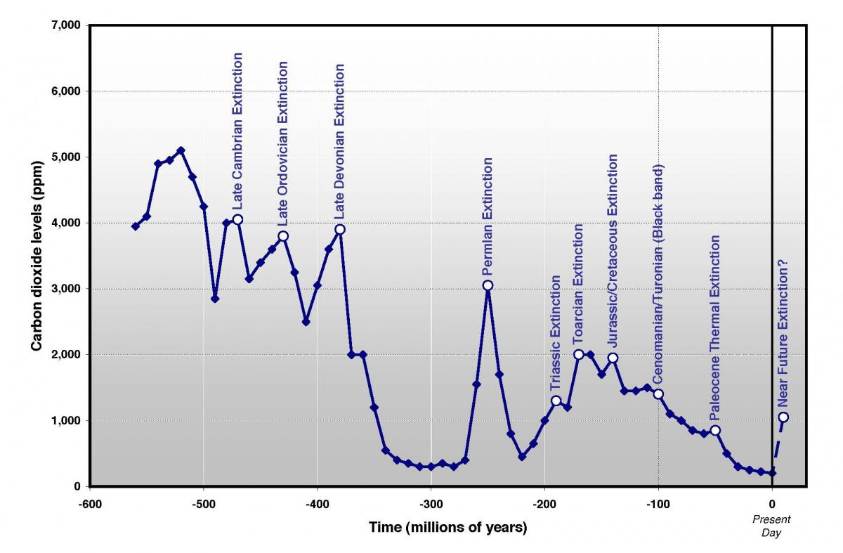
Life On Earth Co-existed And Developed With CO2 Levels Much Higher Than At Present

Slide 8
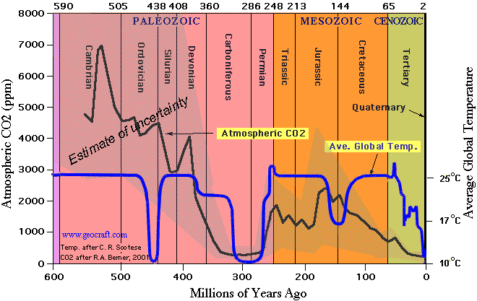
So You Want To Do Something About Climate Change? Carbon Dioxide Is A Poor Choice

Slide 9
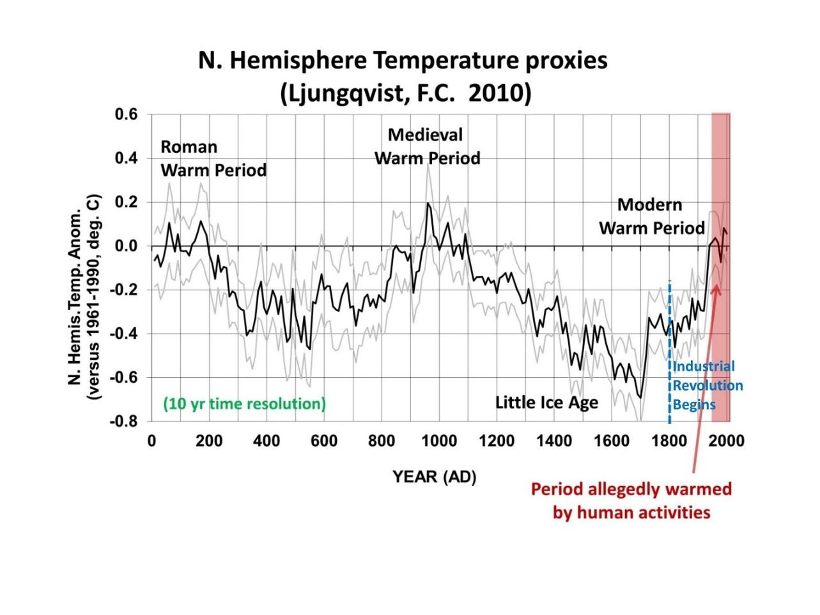
We Are Living On A Mere Blip Of The Geological Time Scale

Slide 10
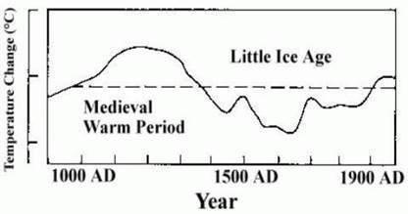
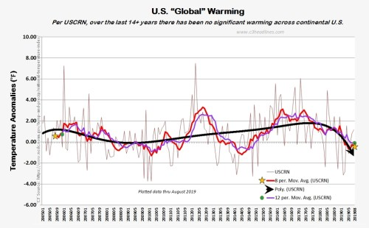
Global Temperatures, Present and Past
Global Temperatures Were Higher When CO2 Was Much Lower
No Significant U. S. Warming Past 14+ Years
Source: Figure 7c from the IPCC FAR
CO2 almost one-half the present value

Slide 11
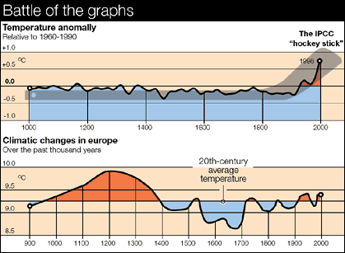
UVA’s Michael Mann and His Temperature “Hockey Stick”
www.wattsupwiththat.com/2009/07/08the-medieval-warm-period-linked-to-...

Slide 12
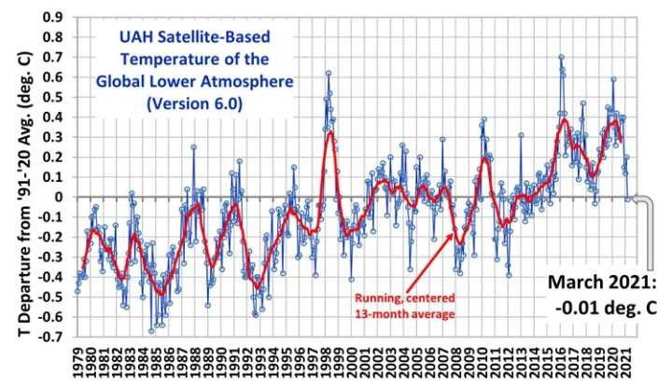
The Linear Warming Trend Since January, 1979 To March 2021 Remains At +0.14 C/decade (+0.12 C/decade Over The Global-Averaged Oceans, And +0.18 C/decade Over Global-Averaged Land)
1984

Slide 13
Why Demonize Carbon Dioxide?
There is no consistent relationship between CO2 levels and global temperature, yet it has been selected as the major determinate of global climate
Water vapor is the number one greenhouse gas, but not amenable to political control or taxation
Climate computers, known as General Circulation Models, are imperfect and incomplete mathematical attempts to include all the factors and their relative interactions which go to make up the global climate over time…they are not representations of reality
What factors are not known are then arbitrarily assigned values in the model
There is no single climate model, but many, indicating a variety of guesses by the computer modelers, which fail to accurately predict future temperature

Slide 14


The True Drivers OF Our Climate
Not Amenable To Taxation

Slide 15

Create Fear = Control
Published 2004:
“I regard consensus science as an extremely pernicious development that ought to be stopped cold in its tracks. Historically the claim of consensus has been the first refuge of scoundrels; it is a way to avoid debate by claiming that the matter is already settled.”

Slide 16
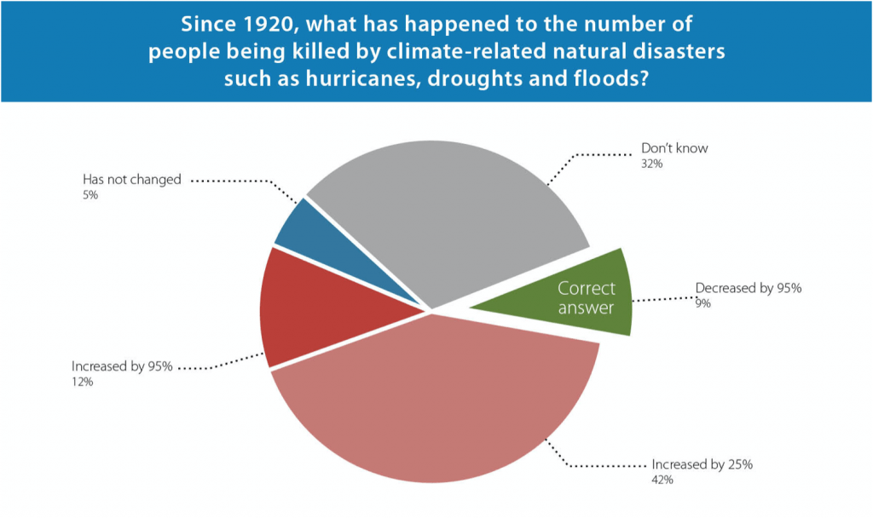
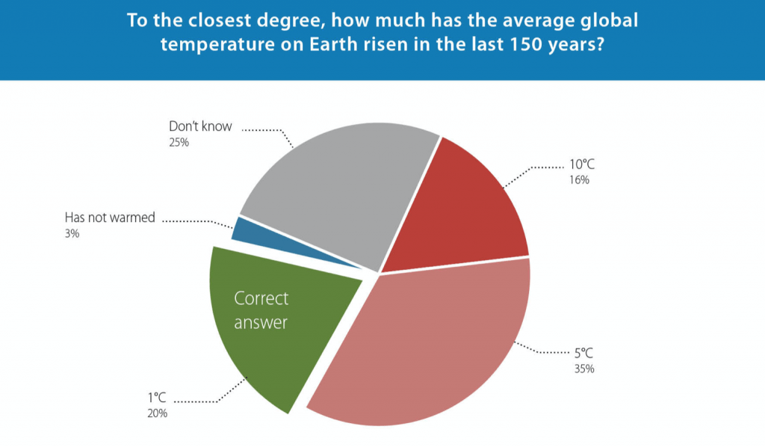
What Are The Public Perceptions?

Slide 17
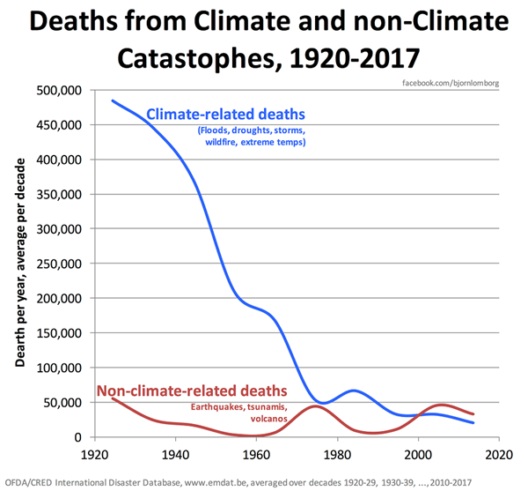
Climate Related Deaths Down 95%

Slide 18
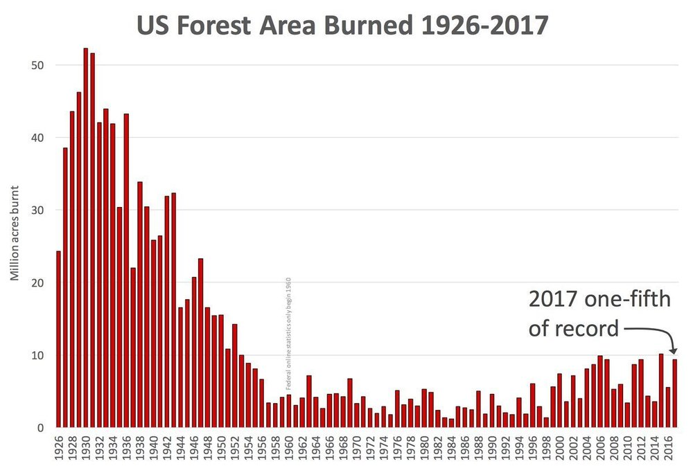
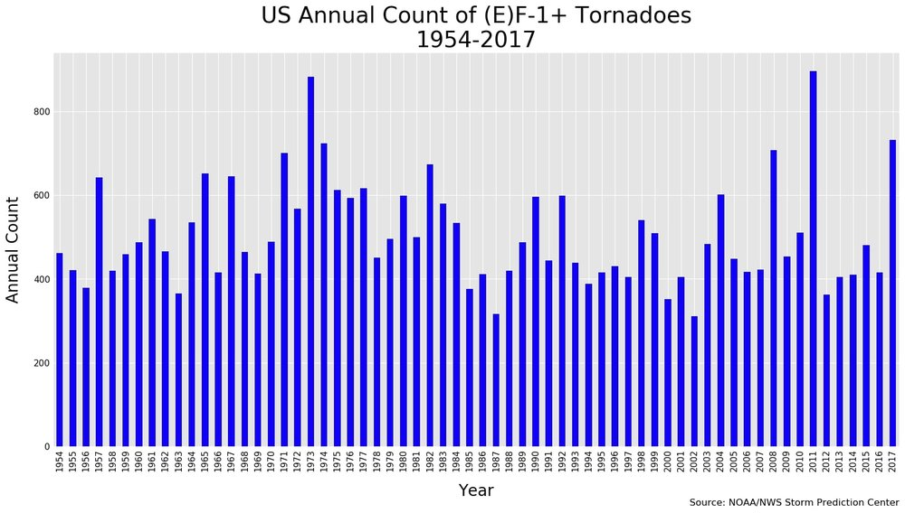
No, Forest fires and Tornadoes Are Not Getting Worse…Where Is the Crisis?
More Fires in 1930s When CO2 Was Much Less
No Increase or Upward Trend in Tornadoes

Slide 19
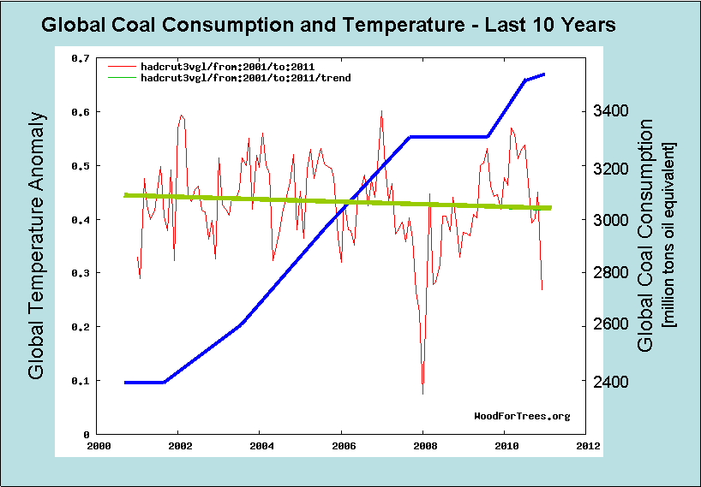
Carbon/Coal Consumption Up, CO2 Up; Global Temperature Down
Notes:
China alone adds one coal fired plant per week; Germany may follow as it tries to replace its nuclear plants. Global temperature trends downward as CO2 trends upward.

Slide 20
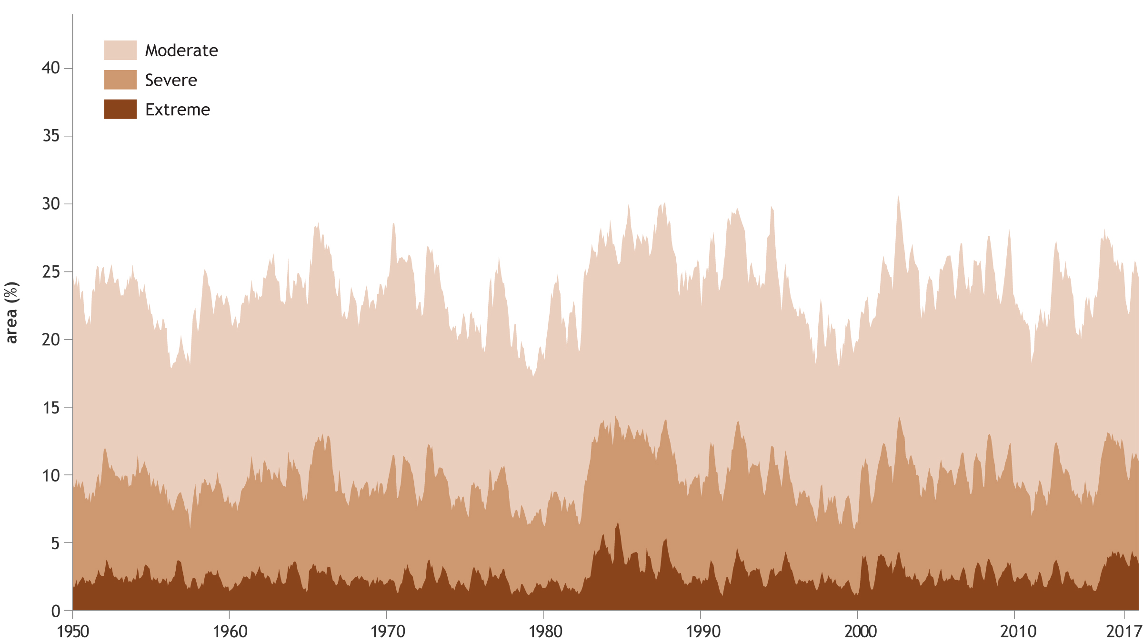
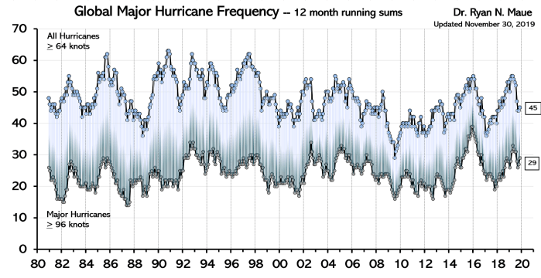
Droughts Not Increasing
Hurricanes Not Increasing
US National Oceanic and Atmospheric Administration (NOAA) show no trend in the proportion of the globe in drought since 1950
Global Hurricanes Have Not Increased in Frequency Nor in Intensity

Slide 21
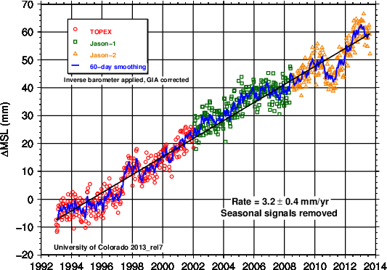
The Average Rate Of Sea Level Rise Remains The Same Average of 7-10 Inches Per Century

Slide 22
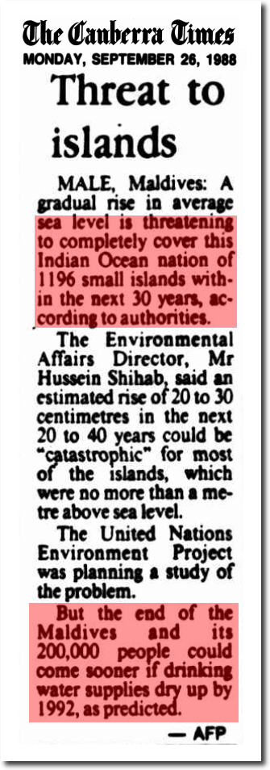
Thirty Years After 1988 Predicting Their End, Maldives Still There Welcoming Tourists
19SEP 2019Influencers from USA Arrive In Maldives to Promote Tourism
Posted By MMPRCUncategorized0 COMMENTS
Maldives Marketing and Public Relation Corporation (MMPRC) welcomed influencers from USA to Maldives for a familiarization trip on 13 September 2019. This is the thirteenth familiarization trip conducted by the corporation for various markets this year. The influencers will spend their time in Diamonds Athuruga, LUX* South Ari Atoll and in Reethi Faru Resort during […]

Slide 23
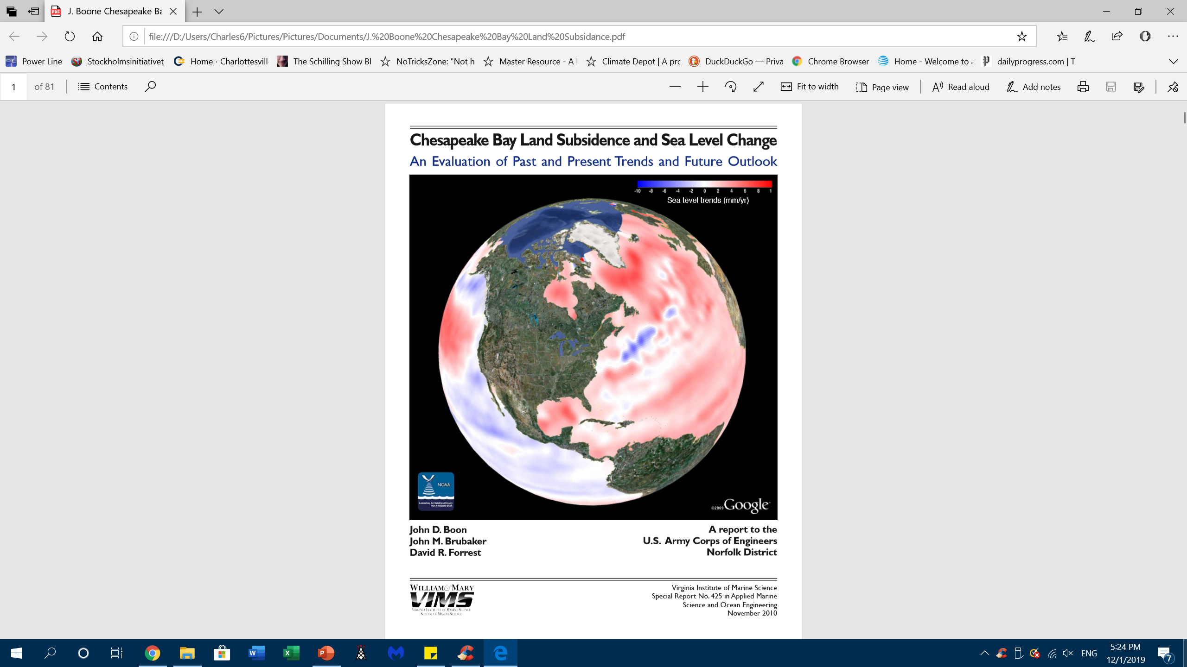
The Atlantic Coast of Virginia is Sinking…
Nothing to Do With Climate Change
“there is presently no evidence of a statistically significant increase (of sea level) indicating an acceleration at any of the five stations with the longest records.”
“It is concluded that approximately 50% of the RSL (Relative Sea Level) rise measured at the bay stations is due to local subsidence.”

Slide 24
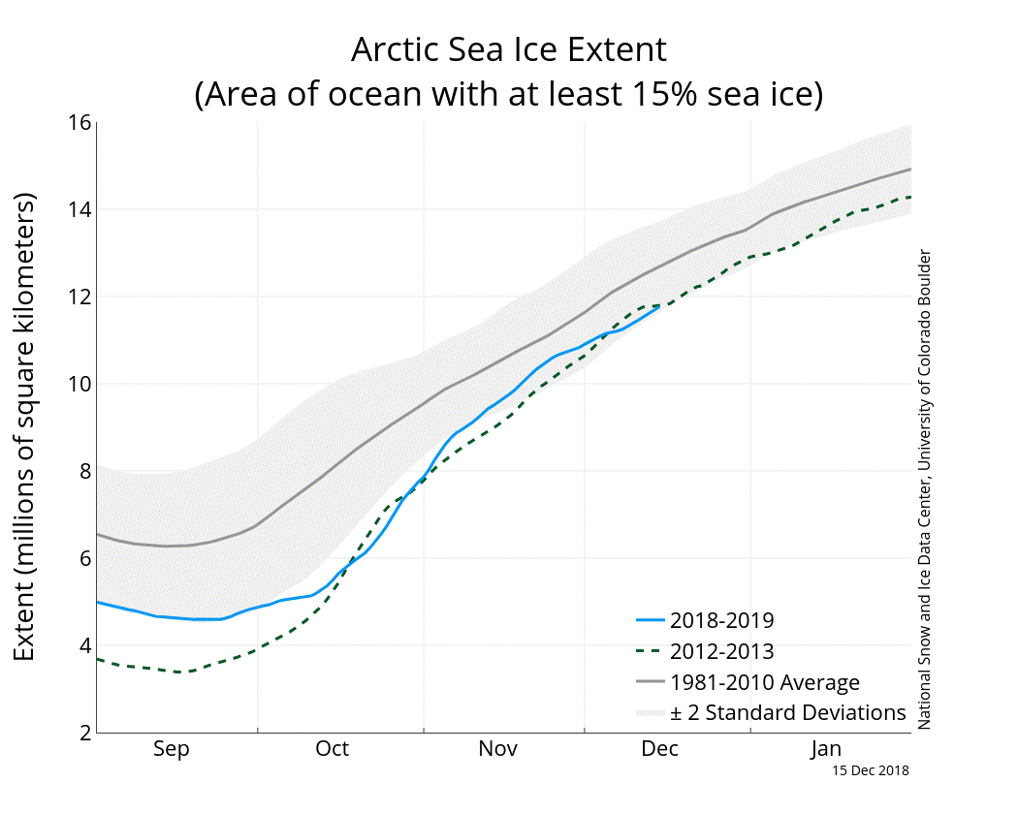
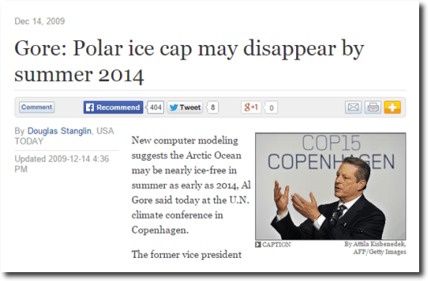
Another Al Gore Climate Prediction (2009) Fails, and Continues to Fail

Slide 25
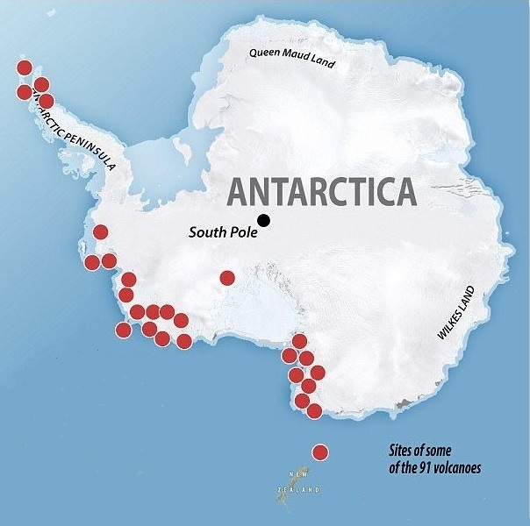
Antarctica Melts From Volcanic Activity From Below

Slide 26
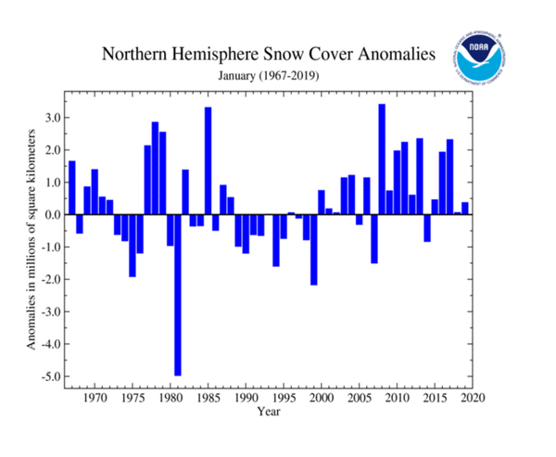
More Snow, Not Less
https://climate.rutgers.edu/snowcover/chart_anom.php?ui_set=1&ui_region=nhland&ui_month=12

Slide 27
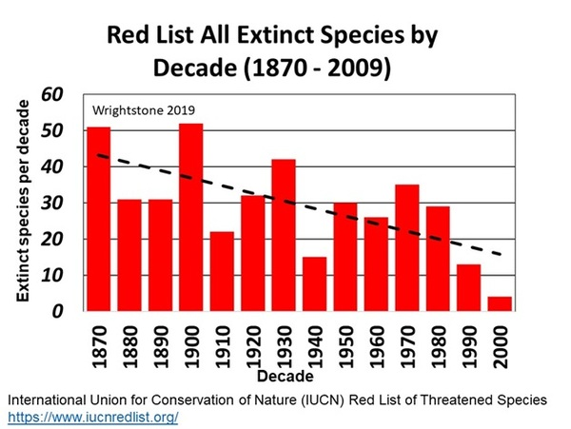
Species Extinctions Down, Not Up
Real Extinctions, Not Computer Predictions

Slide 28

Data published since 2017 show that global polar bear numbers have continued to increase slightly since 2005, despite the fact that summer sea ice in 2018 was again at a low level not expected until mid-century: the predicted 67% decline in polar bear numbers did not occur.*
National Geographic received such a profound backlash from its widely viewed ‘this is what climate change looks like’ starving polar bear video, released in late 2017, that in 2018 it made a formal public apology for spreading misinformation.*
Canadian biologist Dr. Mitchell Taylor, one of the foremost authorities on polar bears, says: "We're seeing an increase in bears that's really unprecedented, and in places where we're seeing a decrease in the population it's from hunting, not from climate change."
Bumper sticker from Cambridge Bay, Nunavut, courtesy Joe Prins. *Zoologist Dr Susan Crockford
2018 State of the Polar Bear Report report
.

Slide 29

University of Victoria (2019) Fires Susan Crockford Ending Her 15-year Stint As An Adjunct Professor For Telling The Truth And Challenging The New Climate Orthodoxy
Crockford: “…Anthropology Department bowed to pressure from the administration, who themselves bowed to pressure from outside the university community, in an attempt to stifle my legitimate scientific criticisms of polar bear conservation issues. This kind of bullying has been happening far too often at universities, even in Canada.”

Slide 30
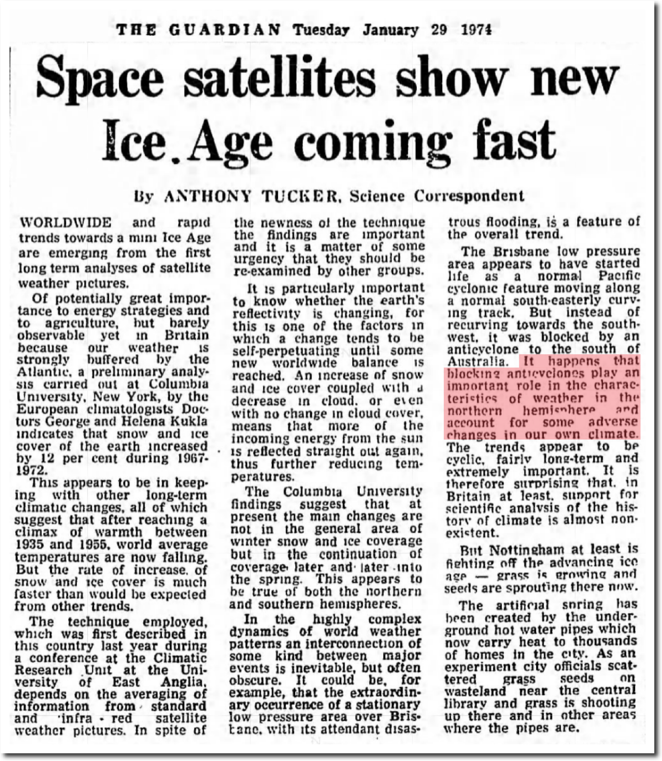

New Ice Age Predicted By Scientists and Widely Reported Almost There in 1974, 1979…
Still Waiting in 2019, But It Is Still Coming
January 1974
December 1979

Slide 31

Ancient Mass Hysteria Repeats In Our Time
Published in 1841
The Mississippi Scheme
The South-Sea Bubble
Tulipomania
The Alchemists
Fortune-Telling
The Magnetizers
The Crusades
The Witch Mania

Slide 32


One a Climate Scientific Treaty
The Other an Economist’s Insight Into The Public’s Gullibility
S. Fred Singer was the founding dean of the School of Environmental and Planetary Sciences at the University of Miami, the first director of the U.S. National Weather Satellite Service, and served five years as vice chairman of the U.S. National Advisory Committee on Oceans and Atmospheres. Emeritus Professor UVA. (2006)
Simon analyzes the various reasons why the crusading doomsayers (P. Ehrlich) who want Americans to believe that we are running out of resources, polluting ourselves to death, and overpopulating the planet have succeeded as much as they have. (1999)

Slide 33

Greenpeace Leader Now Looks Back In 2021 At The Corruption Of Scientific Integrity

Slide 34
John Muir’s Environmental Conservation Ideals Replaced By Wealth Redistribution and Climate Justice
OTTMAR EDENHOFER: lead author of the U.N. IPCC's Fourth Assessment Report 2007
Climate Justice Warrior TIME “Person of the Year” 2019 G. Thunberg
“we redistribute de facto the world's wealth by climate policy… One has to free oneself from the illusion that international climate policy is environmental policy. This has almost nothing to do with environmental policy anymore, with problems such as deforestation or the ozone hole.”
“The climate crisis is not just about the environment. It is a crisis of human rights, of justice and of political will. Colonial, racist and patriarchal systems of oppression have created and fueled it. We need to dismantle them all.”

Slide 35
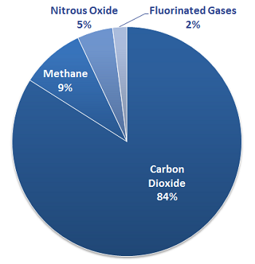
Greenhouse Gases
Science Facts vs. School Indoctrination
Science: Number One Greenhouse Gas is Water Vapor
https://www.britannica.com/science/greenhouse-gas M.Mann
What Your Kids Are Taught
Where Is Water Vapor?
https://study.com/academy/lesson/what-are-greenhouse-gases-lesson-for-kids.html
“Water Vapor is the most potent greenhouse gas in the Earth's atmosphere”
Water vapor, including clouds, constitutes Earth's most significant greenhouse gas, accounting for about 60 to 95% of Earth's greenhouse effect

Slide 36

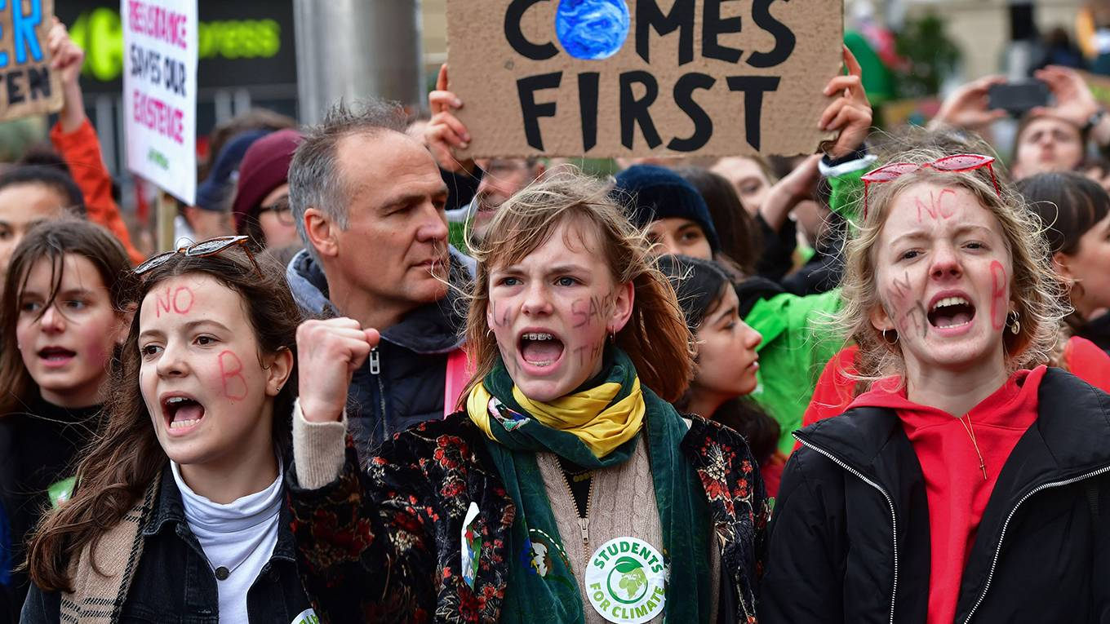
Leading Children Astray Then, and Now?
Illustration by Kate Greenaway for Robert Browning's "The Pied Piper of Hamelin"
https://www.project-syndicate.org/commentary/climate-strikes-un-conference-madrid-by-greta-thunberg-et-al-2019-11

Slide 37
Judges “Determining” Scientific Fact Erroneously Label Carbon Dioxide A “Pollutant”
In Massachusetts v. EPA (2007), the Supreme Court held that greenhouse gases are pollutants under the Clean Air Act.
On December 15, 2009, the Environmental Protection Agency (EPA) determined, based upon a careful review of the scientific record, that greenhouse gas emissions endanger the public health and welfare of current and future generations

Slide 38
Carbon Dioxide: An Essential Life Sustaining Gas
We are all carbon-based life forms
Our lungs operate in a 40,000 ppm environment, at each breath exhalation
Current atmospheric carbon dioxide levels are about 418ppm
Atmospheric carbon dioxide is an essential plant food
Plants provide us with essential oxygen
Without sufficient carbon dioxide plants die
Carbon dioxide is not a pollutant
Notes:
Facts of life

Slide 39
25th U.N. Climate Apocalypse Meeting in Madrid, December 2019
Claiming carbon dioxide is the primary determinate of the climate is a U.N. promoted political project, and excludes natural causation
U.N. climate predictions are computer guesses which have proven to be erroneous
The hypothesis of human-generated CO2 with dangerous or disastrous climatic consequences for humanity, has never been proved

Slide 40
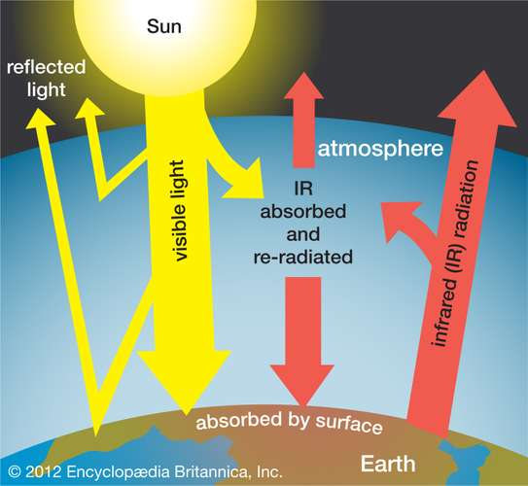
“Greenhouse effect, a warming of Earth’s surface and troposphere (the lowest layer of the atmosphere) caused by the presence of water vapour, carbon dioxide, methane, and certain other gases in the air. Of those gases, known as greenhouse gases, water vapour has the largest effect.” (M.Mann)
https://www.britannica.com/science/greenhouse-effect

Slide 41
In 2001 The UN Let The Cat Out Of The Bag, But The Climate Modelers And Dogmatists Ignore The Fact
“The climate system is a coupled non-linear chaotic system, and therefore the long-term prediction of future climate states is not possible.” UN IPCC 2001 Third Assessment Report, Working Group I
Chaotic in this context refers to MIT climatologist Edward Lorenz who in 1963 postulated the “butterfly effect” which states that small differences in initial conditions will yield widely diverging outcomes thereby rendering long-term prediction impossible in general
All climate computers are subject to this mathematical limitation in attempting to predict future climate states

Slide 42
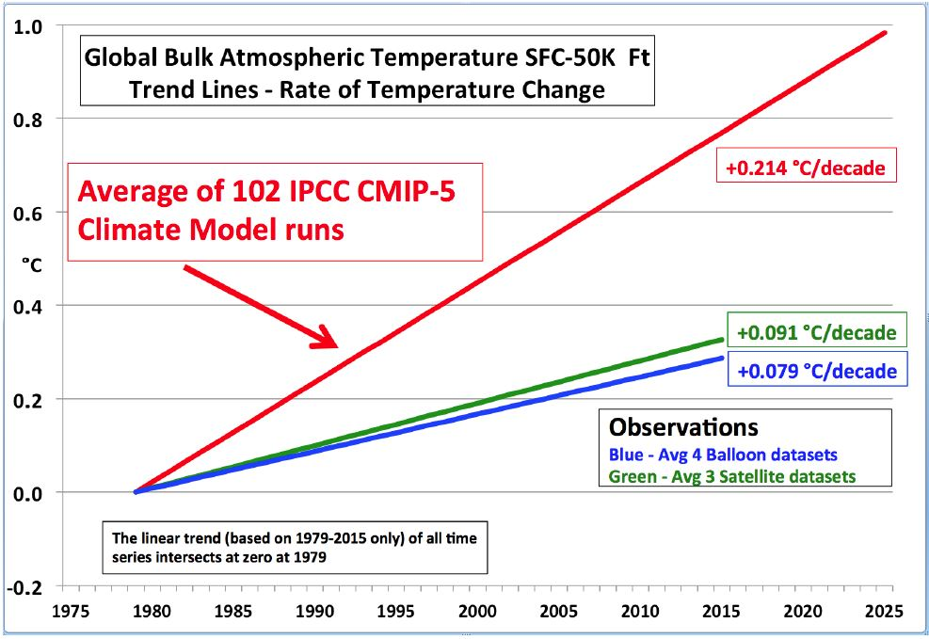
U.N. IPCC Climate Computers Predicted 3X The Actual Warming Over a Fifty Year Period
Albemarle County Pledges to Follow U.N. Anyway!

Slide 43
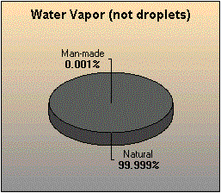
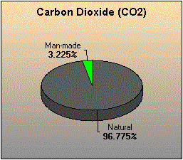
Total Human Greenhouse Gas Contributions
Produce About 0.28% Of The Greenhouse Effect. Man-made CO2 Produces About 0.2% of Earth’s Greenhouse Effect, (factoring in water vapor)
https://www.geocraft.com/WVFossils/greenhouse_data.html

Slide 44
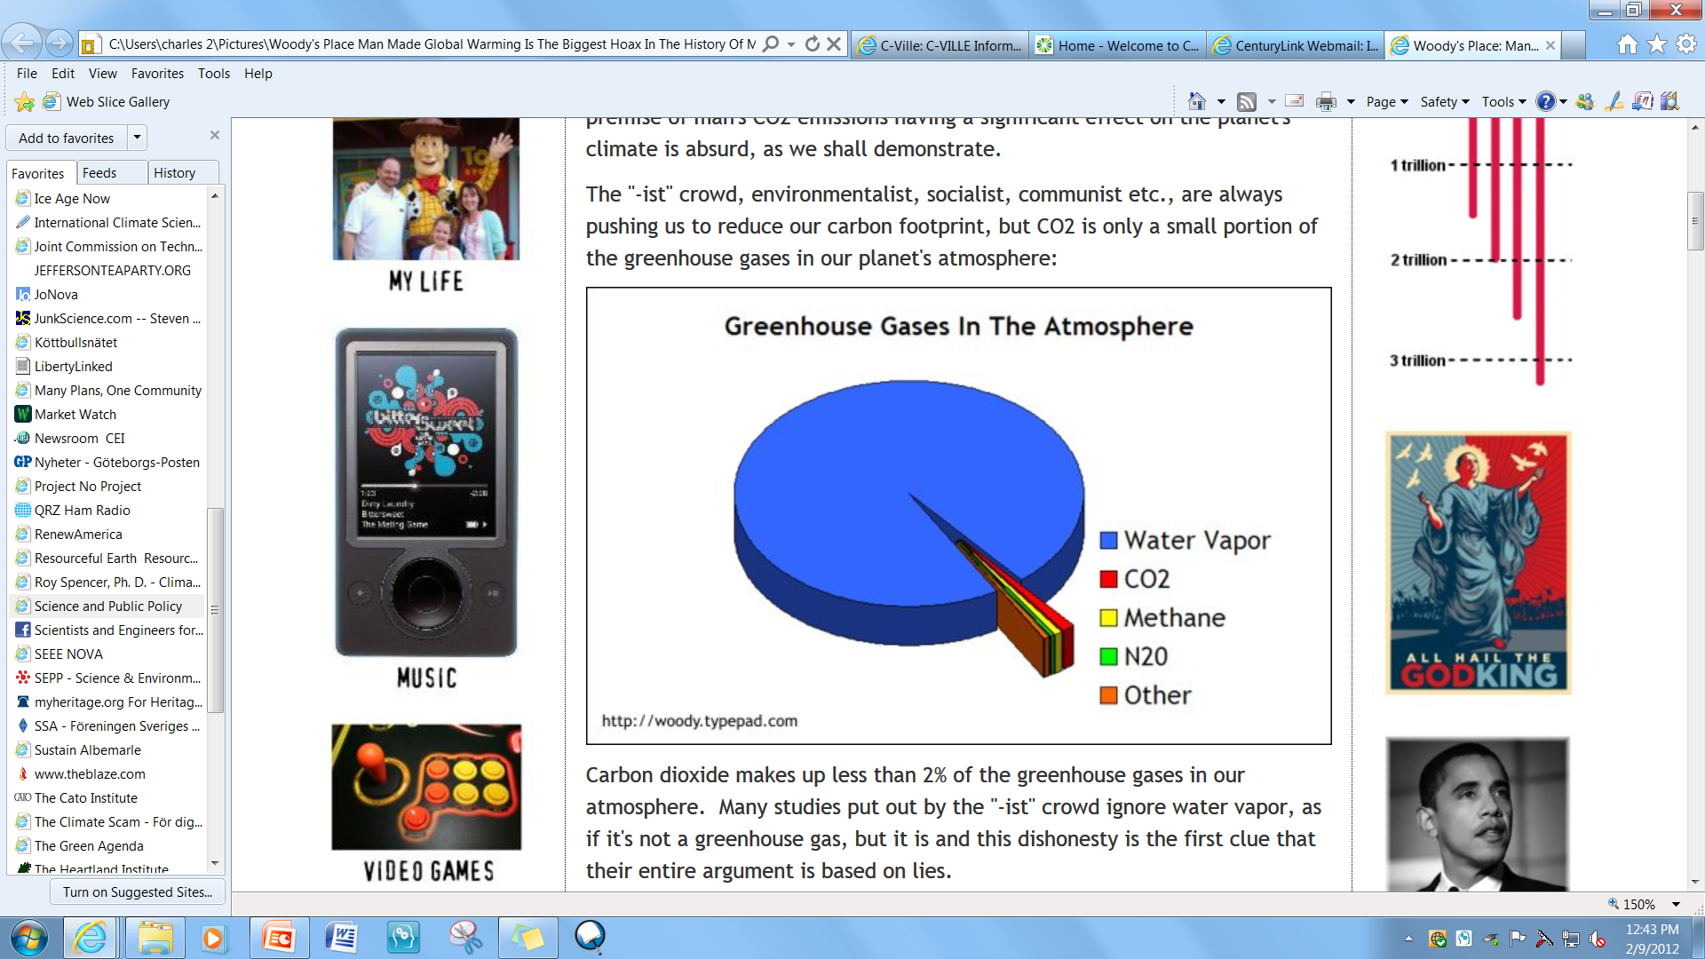
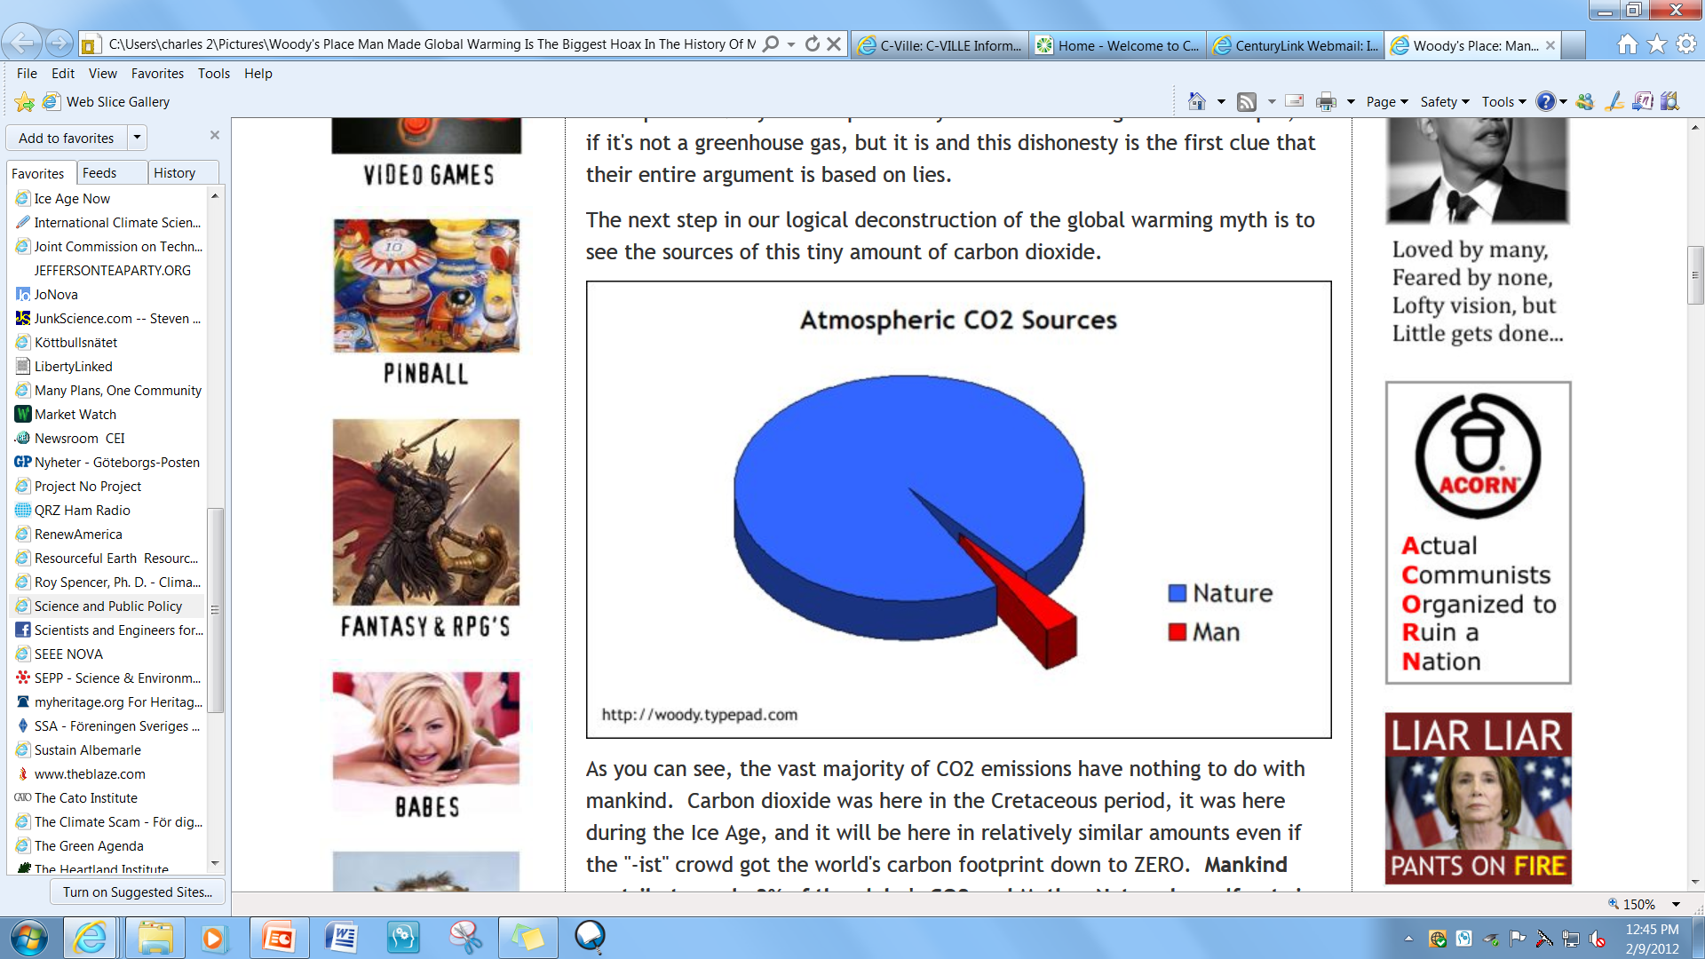
Manmade CO2 Contributes +/- 0.2% Of The Total GHG Effect
Water Vapor Is The Number One Green House Gas
Water = 95% of the GHG Effect
All CO2 Contributes 5%
Mankind Contributes Just 4% Of The Global CO2

Slide 45
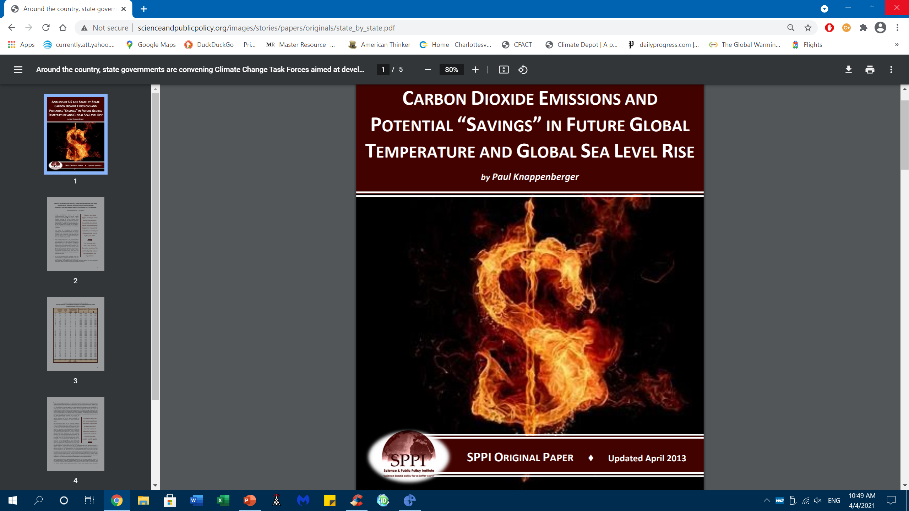
Analysis of Carbon Dioxide Emissions (for 2010) and Potential “Savings” in Future Global Temperature and Global Sea Level Rise from a Complete Cessation of All USA CO2 Emissions
Temperature Rise “Saving”
By 2050 saving = 0.08⁰ C
BY 2100 saving = 0.17⁰ C

Slide 46
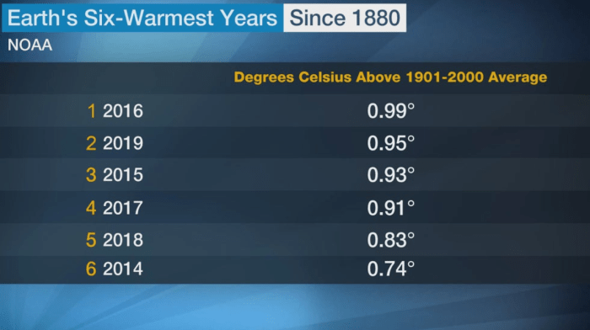
What Warmest Years?
GISS climatologist Gavin Schmidt. “The difference between the second and sixth warmest years is trivial because the known uncertainty in the temperature measurement is larger than some of the differences between the warmest years.” https://www.nasa.gov/home/hqnews/2010/jan/HQ_10-017_Warmest_temps.html

Slide 47
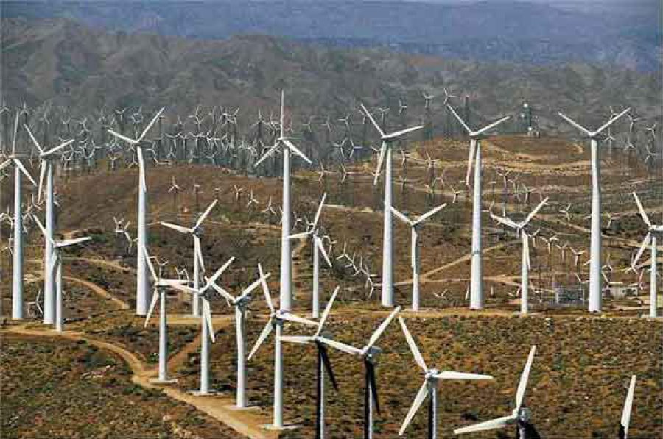
Harvard Study Finds Wind Turbines Warm The U.S.
https://www.cfact.org/2020/02/06/harvard-study-finds-wind-turbines-warm-the-u-s/

Slide 48
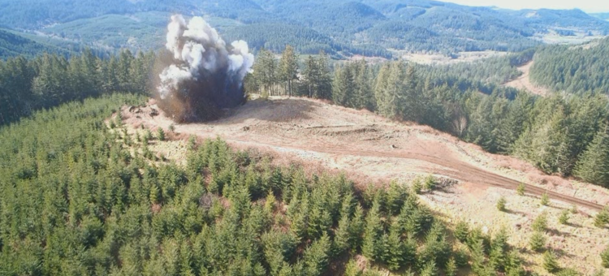
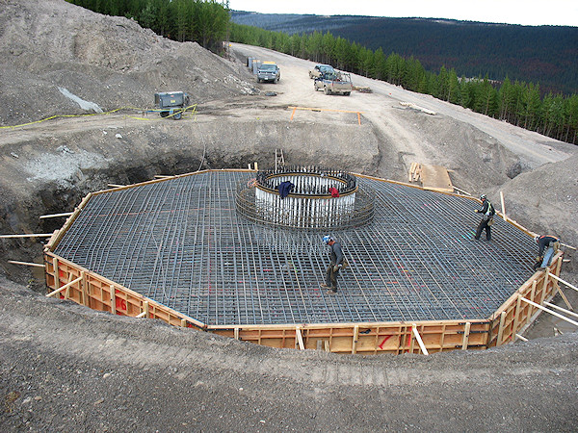
Environmental Destruction To Construct Unreliable Wind Power
Native Habitats Destroyed
For Just A Single Wind Turbine Tons of Steel and Concrete Trucked In
https://savethehuronmountains.org/2018/06/27/mountain-tops-blasted-to-make-room-for-turbines/
http://www.canasteel.com/images/projects/3b.jpg

Slide 49
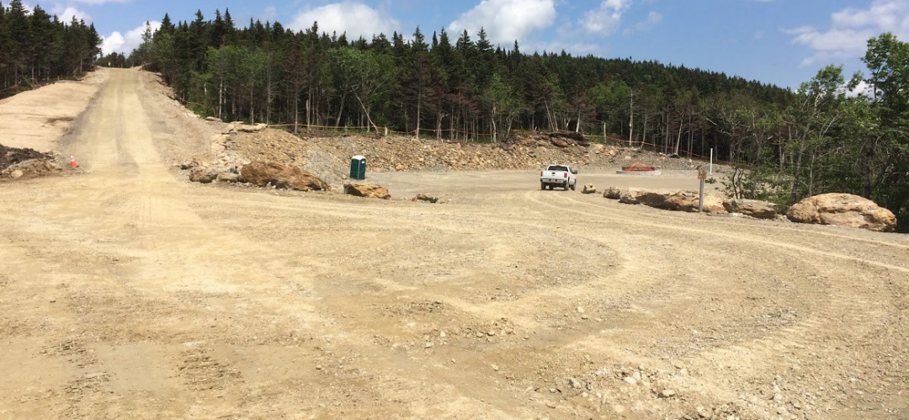
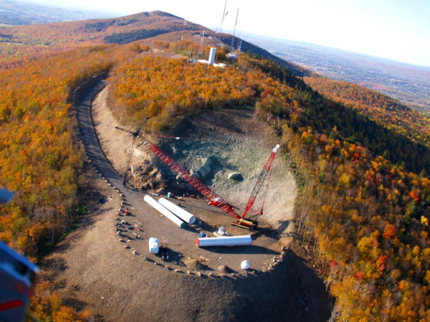
Wind Turbine Construction Carving Roads In Virgin Forests For Transport of Massive Amounts of Concrete and Steel And Subsequent Maintenance
https://savethehuronmountains.org/2018/06/27/mountain-tops-blasted-to-make-room-for-turbines/

Slide 50
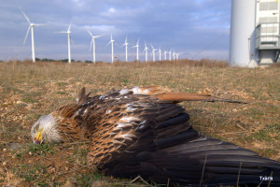
Wind Turbines Slaughter Birds and Lead To Loss of Natural Ecological Balance
Incr
Red kite agonizing under wind turbine, Spain.
Courtesy of association of ecologists GURELUR, Navarre
“Wind turbines kill an estimated 140,000 to 328,000 birds each year in North America, making it the most threatening form of green energy.” Audubon Society
A conservative estimate is that at least 4 million bats have been killed by wind turbines since 2012. Bats are our primary natural defence in keeping mosquito and crop-damaging insect populations in check. One bat can eat between 500 and 1,000 mosquitoes and other insects in just one hour, or about 6,000 per night…

Slide 51
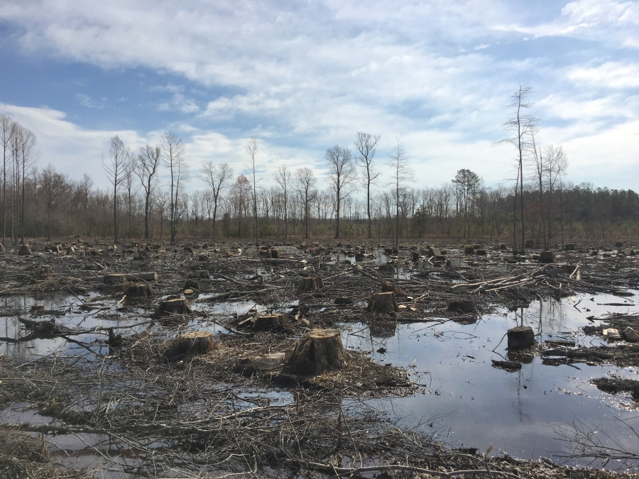
Biomass Based Enviva Owns And Operates Seven Plants In Southeastern United States Producing Over 3 Million Metric Tons Of Wood Pellets Annually Exported Primarily To Power Plants In The United Kingdom And Europe
https://www.pri.org/stories/2018-06-20/uk-s-move-away-coal-means-they-re-burning-wood-us

Slide 52
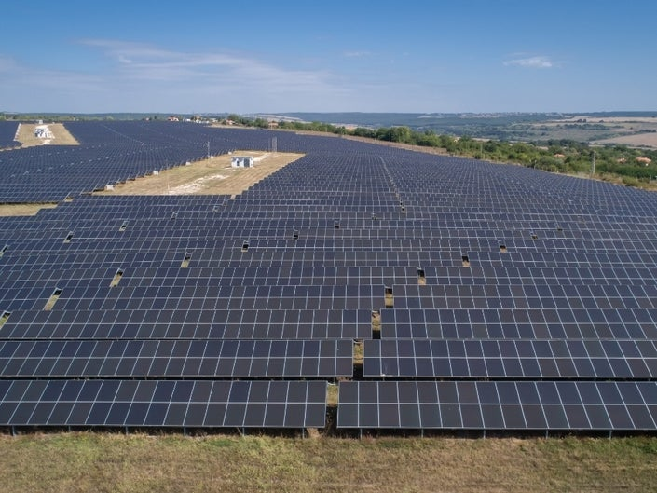
The Spotsylvania Solar Energy Center (Project) Is A “500-Megawatt” Solar Project Located In Western Spotsylvania County, Virginia. The Site Consists Of Three Non-contiguous Boundaries Encompassing Nearly 6,350 Acres and Produces Electricity Only When The Sun Shines
https://patch.com/virginia/fredericksburg/solar-farms-construction-upsets-spotsylvania-residents-report

Slide 53
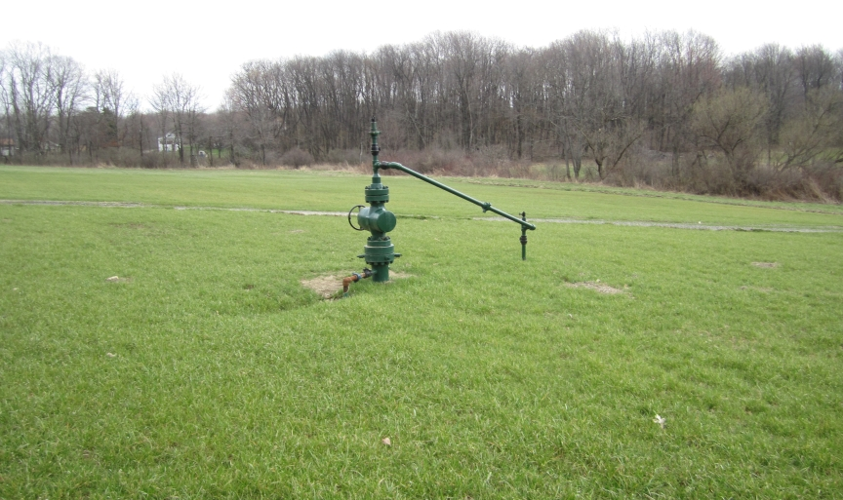

Compare Footprint of Gas Fracking Wellhead And Underground Path To That Of Solar Panels And Wind Turbines…Natural Gas Provides Energy Day and Night
Buried Pipeline After Construction Restoration
Gas Well-Head
https://4.bp.blogspot.com/-K7frHANy_tE/Tegi0zOoqkI/AAAAAAAAAEA/jd43YY1BEd8/s1600/Wellhead.jpg

Slide 54
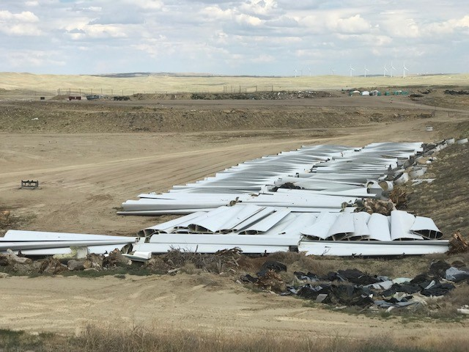
Worn Out Turbine Blades Are Now Major Disposal Hazard For The Environment
https://cowboystatedaily.com/2019/08/07/wind-turbine-blades-being-disposed-of-in-casper-landfill/

Slide 55
E-Vehicle Battery Environmental Disaster In Germany
Batteries Being Discarded Sooner Than Expected
Matthias Schmidt, managing director of the German recycling company Erlos:
“…his industry had expected to be inundated with batteries from recently produced electric cars only in eight or ten years,”
“In fact, however, thousands of tons of batteries are already ending up at waste disposal companies.”
“We would never have imagined the quantities that would accumulate after such a short time,” says Schmidt. His company alone and competitor Duesenfeld, both of which specialize in recycling car batteries, are recycling more than 4,000 tons of batteries from almost all e-models this year – including those that have only recently come onto the market.”

Slide 56
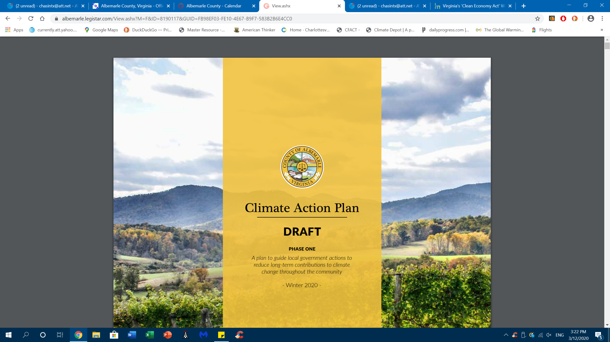
Albemarle County Fantasy Forty-One Page Plan With Zero Climate Impact
No Cost Benefit Analysis…how much will these policies impact climate change, how will success be measured, and at what taxpayer cost in dollars and loss of freedoms?
Depends on outdated political consensus science of United Nations IPCC and outdated references
Ignores latest scientific data to the contrary; U.N. IPCCC AR6 is underway with lowered computer predictions for temperature change
Ignores fact that the human contribution to global climate change can not be distinguished from natural background changes
Get used to bicycle riding, summer and winter
Electric cars = Emission Elsewhere Luxury Cars
Ignores Study Showing That If All of Virginia Abandons All Fossil Fuel Use The Temperature Savings By 2050 Would be:
0.0016 Degree C

Slide 57
Albemarle County Must Be Smarter Than Google Engineers
A research effort by Google corporation to make renewable energy viable has been a complete failure:
“We felt that with steady improvements to today’s renewable energy technologies, our society could stave off catastrophic climate change. We now know that to be a false hope …
Renewable energy technologies simply won’t work;”
http://spectrum.ieee.org/energy/renewables/what-it-would-really-take-to-reverse-climate-change

Slide 58
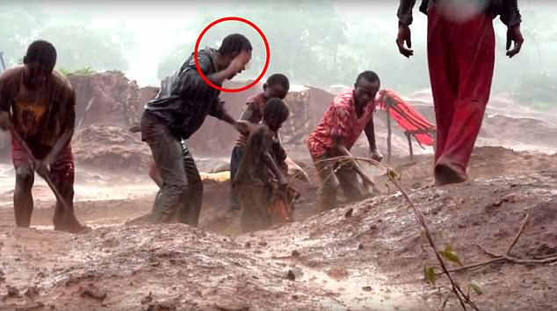
Electric Vehicles Do Not Cure the Climate
EVs= “Emission Somewhere Else” Green Virtue Chariots
Out of sight out of mind?
“Child miners aged four living a hell on Earth so You can drive an electric car”
Inconvenient EV Baggage
Eight-year-old Dorsen is pictured cowering beneath the raised hand of an overseer who warns him not to spill a rock
Coal or natural gas powered electric generating plants will be charging most EVs
EV car battery manufacture and disposal create a huge toxic environmental impact
Commercial scale wind and solar power plants are inefficient, require fossil fuel power-plant backups, consume huge amounts of concrete, steel, and rare earth elements , and create a toxic environmental footprint
New wind farm = New fossil fuel plant
These “renewable energy plants’ live on government tax subsidies and grants, and drive up electric energy costs to consumers
https://www.dailymail.co.uk/news/article-4764208/Child-miners-aged-four-living-hell-Earth.html

Slide 59
Solar And Wind Power Renewables Receive Huge Governmental Taxpayer Subsidies And Provide Huge Profits To Wall Street And Investors
On a dollar per megawatt hour basis:
Solar receives $24.34
Wind receives $23.37
Nuclear receives $ 1.59
Hydro receives $ .67
Coal receives $ .44
Oil receives $ .25
Based on the unproven and false hypothesis that carbon dioxide rules the global climate, a money making craze/scam has swept all aspects of our society with green virtue signaling the face of corporate America, and billions are wasted to decarbonize society, just as we are entering another global cooling era.
Data: U.S. Energy Information Administration 2008

Slide 60
March 2016: Free Speech Threatened By Federal Policy
(No Scientist Denies “Climate Change”)…
More Of The Same In 2021
U.S. Attorney General Loretta Lynch told the Senate Judiciary Committee that not only has she discussed internally the possibility of pursuing civil actions against so-called “climate change deniers,” but she has “referred it to the FBI to consider whether or not it meets the criteria for which we could take action.” - See more at: http://www.thegwpf.com/americas-new-inquisition-u-s-attorney-general-lynch-looks-into-prosecuting-climate-change-deniers/#sthash.MicWwdh2.dpuf

Slide 61
With A Closing Credit To Forrest Gump
…and “just like that”
the “climate emergency” was gone

