Slide 1
Restoring A Sense of Climate Perspective
Albemarle County BOS Meeting
February 5 , 2020
Charles G. Battig, M.S.,M.D.
Virginia Scientists and Engineers for Energy and Environment
CO2Coalition

Slide 2
Climate and Weather Changes Are Normal and Unstoppable
The temperature plunge in Alaska this winter (2020) has startled many residents, after the state recorded its warmest year ever in 2019.
Fairbanks, Alaska’s third-most populous city, this January 2020 recorded 10 days of minus 30 degrees Fahrenheit, the longest such stretch since 2012. The mercury in Anchorage, Alaska’s largest city, fell below zero 16 of the first 21 days in January, averaging about 20 degrees below normal.
https://www.wsj.com/articles/how-cold-is-it-in-alaska-the-sled-dogs-are-wearing-booties-11579799359?mod=hp_featst_pos3

Slide 3
Environmentalists’ Panic of the Moment Technique: “Scaring The Public”
2007 Virginia Climate Action Conference UVA October 27, 2007: (Chesapeake Climate Action Network)… major concern and evidence of global warming impact was Atlanta reservoir Lake Lanier down 20 feet. This finding was given as one proof of disastrous manmade global warming secondary to atmospheric carbon dioxide increase. This UVA event was advertised as being conducted by an Al Gore trained presenter.
January 2020 Lake Lanier report has reservoir level of 1070 feet…full reservoir is 1071 feet!
Thirteen years later, CO2 up, water level up…where is the good news report? Sierra Club and Chesapeake Climate Action Network seem to specialize in scare stories.

Slide 4
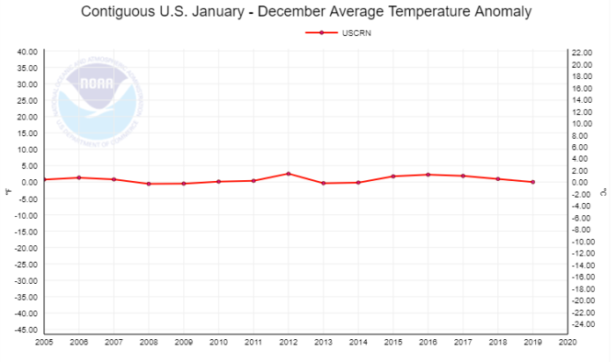
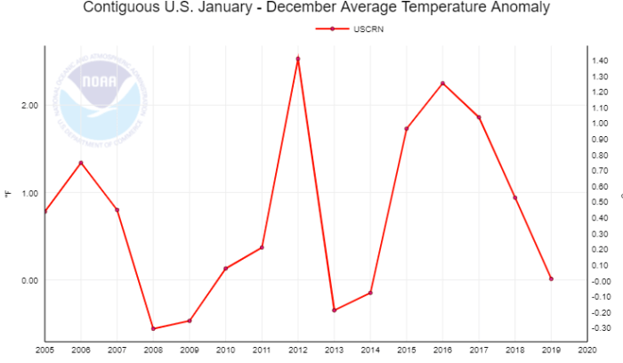
Where is the Existential Crisis? Only In Scary Presentation Theatrics
What We Feel
Same Data Presented As Evidence of a Climate Threat

Slide 5
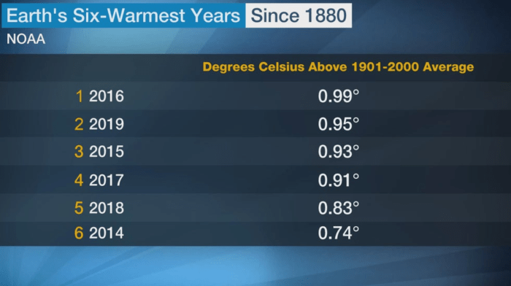
What Warmest Years?
GISS climatologist Gavin Schmidt. “The difference between the second and sixth warmest years is trivial because the known uncertainty in the temperature measurement is larger than some of the differences between the warmest years.” https://www.nasa.gov/home/hqnews/2010/jan/HQ_10-017_Warmest_temps.html

Slide 6
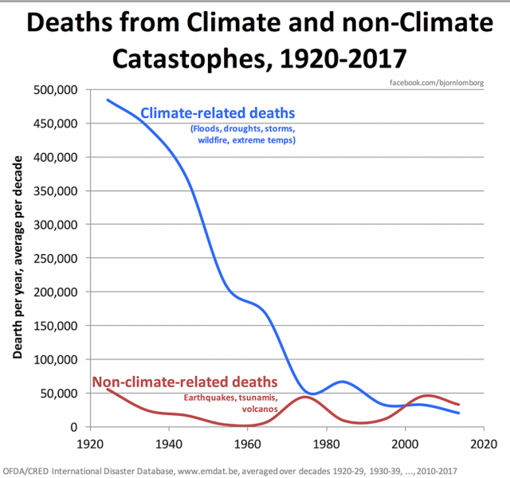
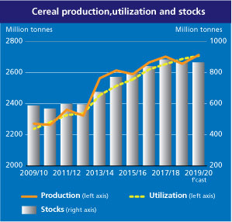
What Existential Threat?
Global Production of Cereal Grains Going UP, UP, and UP
Climate Deaths Are Going DOWN
http://www.fao.org/worldfoodsituation/csdb/en/

Slide 7
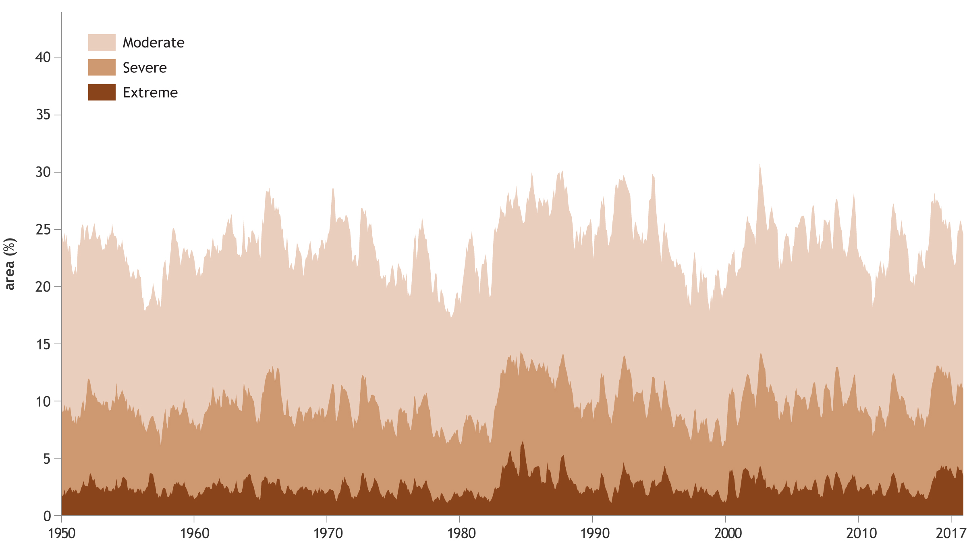
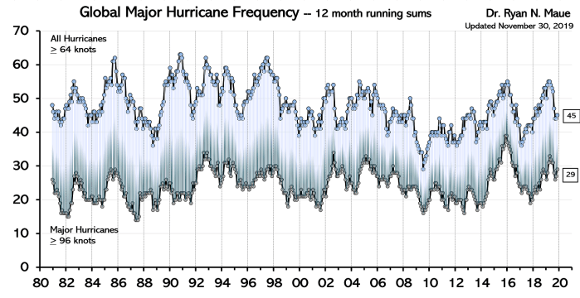
Droughts Not Increasing
Hurricanes Not Increasing
US National Oceanic and Atmospheric Administration (NOAA) show no trend in the proportion of the globe in drought since 1950
Global Hurricanes Have Not Increased in Frequency Nor in Intensity

Slide 8
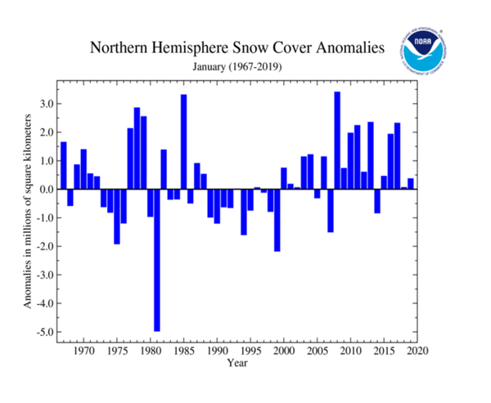
More Snow, Not Less
https://climate.rutgers.edu/snowcover/chart_anom.php?ui_set=1&ui_region=nhland&ui_month=12

Slide 9
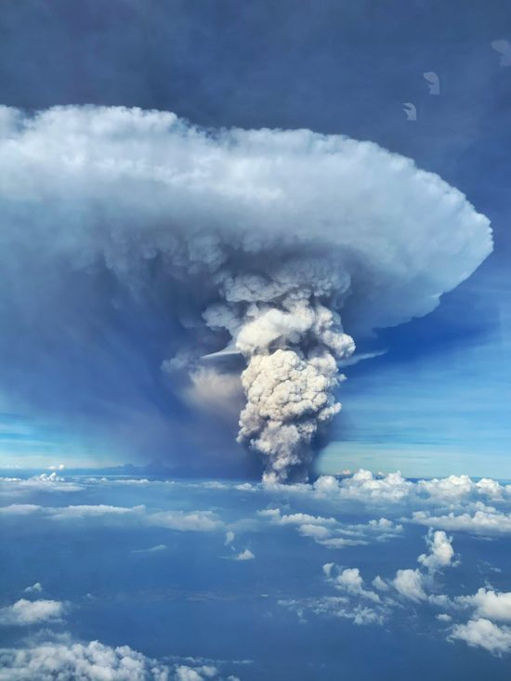
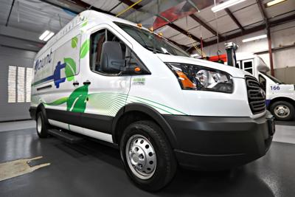
Nature Speaks the Loudest
Philippine Taal Volcano’s Carbon Footprint
Albemarle’s Carbon Footprint Reduction Solution

Slide 10
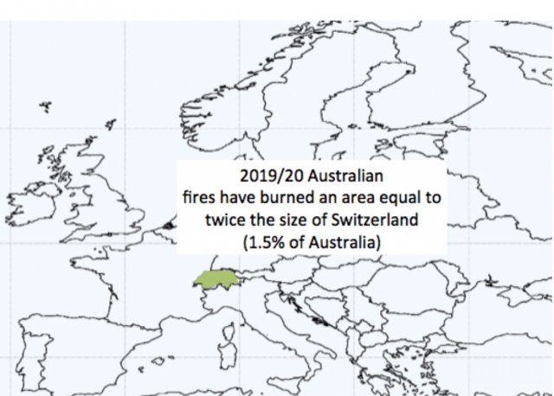
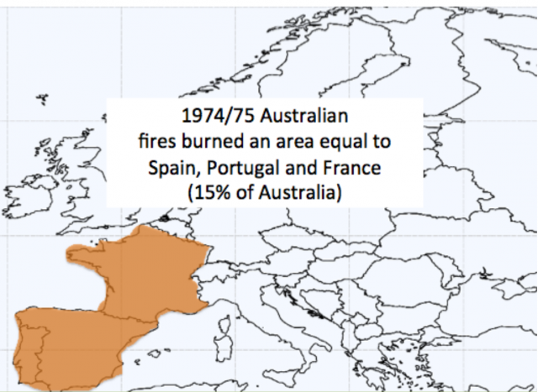
Australia’s Long History of Wildfires
Australian Fires 2019/2020
Australian Fires 1974/1975
https://www.cfact.org/2020/01/27/what-the-media-wont-tell-you-about-the-australian-wildfires/

Slide 11
So What Does Drive Albemarle BOS Climate Policy?
It does not seem to be factual scientific data.
Is it just green virtue signaling and favored special interest groups?

