Slide 1
Changing the Unchangeable In 2020…
Albemarle’s Futile Dedication to the U.N. Futile Climate Agenda
Albemarle County BOS Meeting
January 8, 2020
Charles G. Battig, M.S.,M.D.
Virginia Scientists and Engineers for Energy and Environment
CO2Coalition

Slide 2
Quotes From H. L. Menken Characterize Climate Emergency Propaganda
The urge to save humanity is almost always a false front for the urge to rule.
The whole aim of practical politics is to keep the populace alarmed (and hence clamorous to be led to safety) by menacing it with an endless series of hobgoblins, all of them imaginary.

Slide 3
Stephen Schneider, Lead Author in Working Group II U.N. Intergovernmental Panel on Climate Change (IPCC) Third Assessment Report 2001, Politicizes Climate Science As U.N. Policy
“…to reduce the risk of potentially disastrous climatic change…we need to get some broad-based support, to capture the public’s imagination. That, of course, entails getting loads of media coverage. So we have to offer up scary scenarios, make simplified, dramatic statements, and make little mention of any doubts we might have.”

Slide 4
What Climate Emergency? Catastrophe? Life Spans Are Increasing!
“In the decade from 2004 to 2013, worldwide climate-related deaths (including droughts, floods, extreme temperatures, wildfires, and storms) plummeted to a level 88.6 percent below that of the peak decade, 1930 to 1939.² The year 2013, with 29,404 reported deaths, had 99.4 percent fewer climate-related deaths than the historic record year of 1932, which had 5,073,283 reported deaths for the same category.”
https://www.cato.org/blog/one-statistic-climate-catastrophists-dont-want-you-know

Slide 5

Reassuring Facts Do Not Reach The Children, Why?
But Scare Stories Do!
UVA Professor Does Her Bit With “Might” and “Possibly” Scenarios
2019 U.N. Scary Stories Target Children
“I recently spoke to my son’s eighth-grade class…They might see entire summers in Charlottesville with temperatures over 95°F, up to three feet of sea level rise on our coast, and devastating floods Possibly much worse — disruption to our economy, food shortages, climate refugees and conflict.”
Opinion/Letter DP Dec. 7, 2019 “Thanks to UVa for climate commitment”
https://climatechangedispatch.com/children-terrified-climate-doom-video/

Slide 6
John Muir’s Environmental Conservation Ideals Replaced By Wealth Redistribution, Climate Justice Now, and Action Now
OTTMAR EDENHOFER: lead author of the U.N. IPCC's Fourth Assessment Report
Now: Climate Justice Warrior TIME “Person of the Year” G. Thunberg
“we redistribute de facto the world's wealth by climate policy… One has to free oneself from the illusion that international climate policy is environmental policy. This has almost nothing to do with environmental policy anymore, with problems such as deforestation or the ozone hole.”
“The climate crisis is not just about the environment. It is a crisis of human rights, of justice and of political will. Colonial, racist and patriarchal systems of oppression have created and fueled it. We need to dismantle them all.”

Slide 7
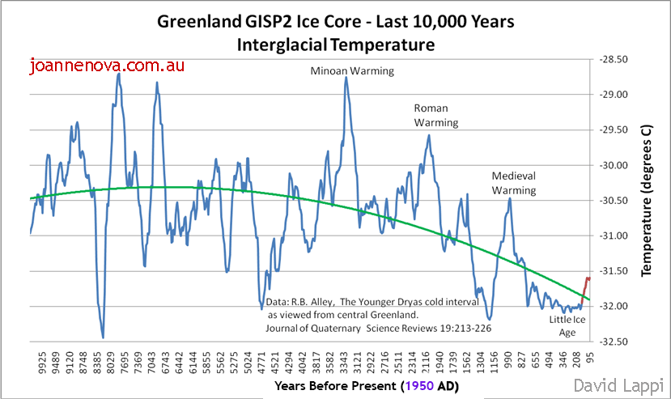
Current Climate Hysteria Is Focused on the Red Temperature Blip At Lower Right Graph

Slide 8
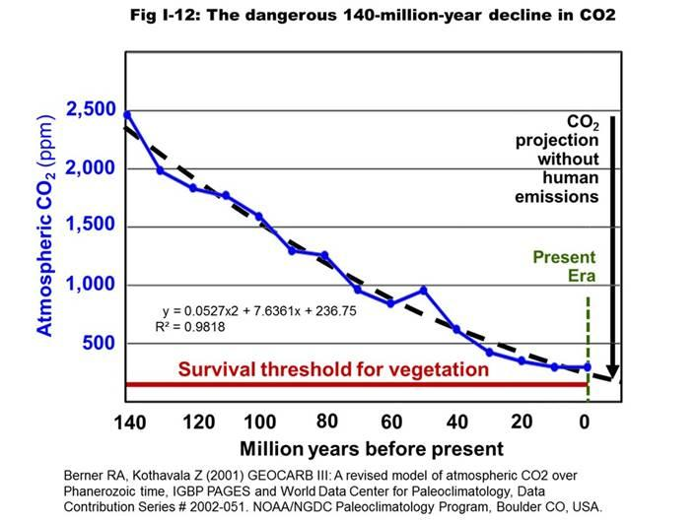
CO2 Is Essential For Life
If Plants Die for Lack of CO2, We Die

Slide 9
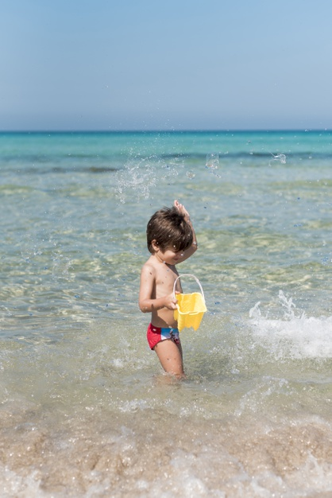
Albemarle County Fighting Sea Level Rise and Climate Change…One Bucket at a Time?

