Slide 1
2019 Year End Summary
Albemarle County’s Misplaced Climate Activism Fosters Constitutional Rights Concerns
December 18, 2019
BOS Albemarle County, VA
Charles G. Battig, M.S.,M.D.
Virginia Scientists and Engineers for Energy and Environment
CO2Coalition

Slide 2

The Atlantic Coast of Virginia is Sinking…
Relative Sea Rise Nothing to Do With Climate Change, Carbon Footprints, or CO2
“there is presently no evidence of a statistically significant increase (of sea level) indicating an acceleration at any of the five stations with the longest records.”
“It is concluded that approximately 50% of the RSL (Relative Sea Level) rise measured at the bay stations is due to local subsidence.”

Slide 3
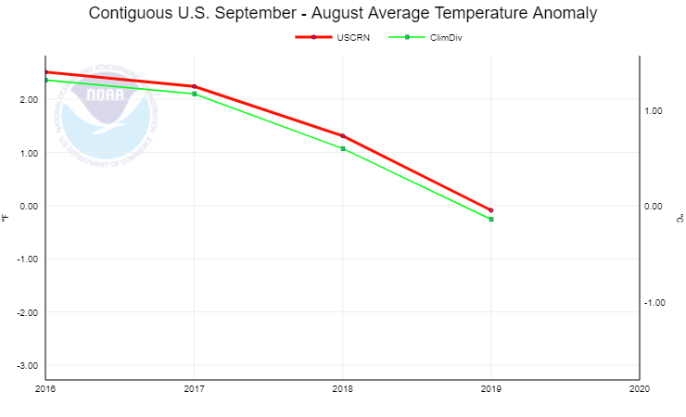
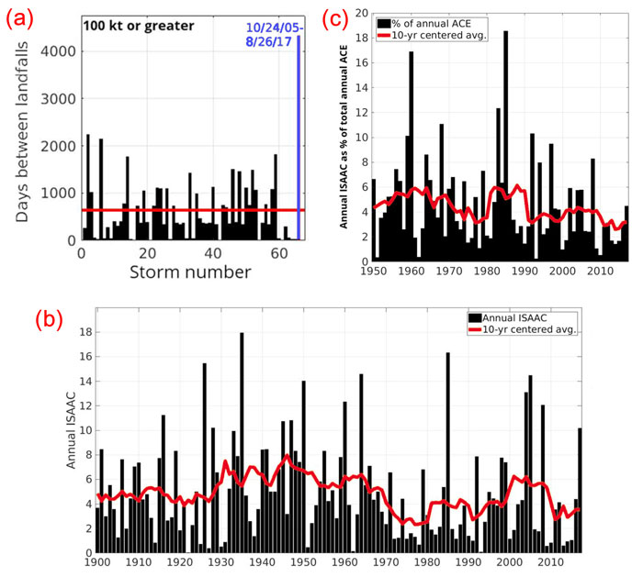
“Climate Emergency” Is A U.N. Political Slogan, Not Scientific Fact
NOAA: U.S. 2016-2019 Temperatures Are Headed DOWN, Even in Summer
No Increase in U.S. Hurricane Frequency or Magnitude 1900-2019
https://www.ncdc.noaa.gov/temp-and-precip/national-temperature-index/time-series?datasets%5B%5D=uscrn&datasets%5B%5D=climdiv&parameter=anom-tavg&time_scale=12mo&begyear=2016&endyear=2019&month=8
https://www.masterresource.org/hurricane-harvey/no-significant-trend-in-u-s-hurricanes-over-the-period-1900-2017-article-review/

Slide 4
Think Big, Think China, Think Coal, Think CO2
Know That Nothing That Albemarle County Can Propose Will Have Any Climate Effect
From January 2018 to June 2019, China added 43 gigawatts (GW) of net new coal power capacity to its existing 1,000 GW coal fleet…the rest of the world collectively reduced coal capacity by 8 GW.
China today: 147.7 GW of coal plants are under active construction or under suspension and likely to be revived—an amount nearly equal to the existing coal power capacity of the European Union (150 GW).
One gigawatt = 1,000,000,000 watts = one billion watts
https://endcoal.org/wp-content/uploads/2019/11/Out-of-Step-English-final.pdf

Slide 5
U.N. Paris Climate Accord Adopted By Albemarle County Stacked Against U.S.A. Interests
“China will be able to increase emissions by a staggering number of years — 13. They can do whatever they want for 13 years. Not us. India makes its participation contingent on receiving billions and billions and billions of dollars in foreign aid from developed countries…the bottom line is that the Paris Accord is very unfair, at the highest level, to the United States.”
https://www.whitehouse.gov/briefings-statements/statement-president-trump-paris-climate-accord/

Slide 6

Danish Academic: U.N. Might Use Military to Enforce Climate Agenda
“this is your emission target, it’s not negotiable, we can actually take military measures if you don’t fulfil it’, then you would basically have to get that down the throat of your population, whether they like it or not,” he says
https://www.breitbart.com/environment/2019/12/03/danish-academic-u-n-might-use-military-to-enforce-climate-agenda/

Slide 7
U.N. and EU On the Way to Climate and Social Totalitarianism Using U.N. Climate Propaganda
EU recently declared “a climate emergency” after a vote of 429 MEPs in favour and 225 against. “Europe became the first continent to make this declaration,” Euronews.com
“State of Emergency”: A situation in which a government is empowered to perform actions or impose policies that it would normally not be permitted to undertake. Such declarations alert citizens to change their normal behavior…”
German Chancellor Angela Merkel’s speech on freedom of expression: “freedom of speech has its limits” and “we have to take away your freedom of speech, or else society won’t be free.”

Slide 8
Why Has Albemarle County Acted Against U.S. Interests?
We recite the Pledge of Allegiance before each BOS meeting.
The BOS members have sworn to uphold the U.S. Constitution.
But why the did they vote to adopt the U.N. Paris Accord when any such county action will have no discernable effect on the climate, and at what cost to the county taxpayers? Nobel Cause Elitism? Feel Good Politics? Green Virtue Signaling? Science Denial? Corporate/Political Cronyism?

Slide 9
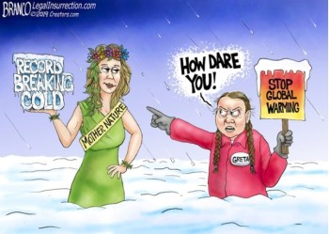
Happy 2020 New Year!

