Slide 1
Captive Academics Invoke “Appeal to Authority”
BOS Albemarle County, VA November 6, 2019
Charles G. Battig, M.D.
Virginia Scientists and Engineers for Energy and Environment
CO2 Coalition
The Right Climate Stuff
www.climateis.com

Slide 2
Warning, If You Want to Keep Your Job
“It is dangerous to be right in matters on which the established authorities are wrong.”
"The Age of Louis XIV". Book by Voltaire, 1751.

Slide 3
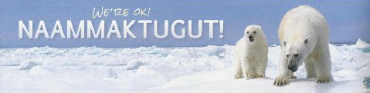
Dr Susan Crockford: Data published since 2017 show that global polar bear numbers have continued to increase slightly since 2005, despite the fact that summer sea ice in 2018 was again at a low level not expected until mid-century: the predicted 67% decline in polar bear numbers did not occur*
National Geographic received such a profound backlash from its widely viewed ‘this is what climate change looks like’ starving polar bear video, released in late 2017, that in 2018 it made a formal public apology for spreading misinformation.*
Canadian biologist Dr. Mitchell Taylor, one of the foremost authorities on polar bears, says: "We're seeing an increase in bears that's really unprecedented, and in places where we're seeing a decrease in the population it's from hunting, not from climate change." 1973 treaty limited hunting!
Bumper sticker from Cambridge Bay, Nunavut, courtesy Joe Prins. *Zoologist Dr Susan Crockford
2018 State of the Polar Bear Report report
.

Slide 4

University of Victoria (2019) Fires Susan Crockford Ending Her 15-year Stint As An Adjunct Professor
Crockford: “…Anthropology Department bowed to pressure from the administration, who themselves bowed to pressure from outside the university community, in an attempt to stifle my legitimate scientific criticisms of polar bear conservation issues. This kind of bullying has been happening far too often at universities, even in Canada.”

Slide 5
UVA Environmental Sciences Professor Pat Michaels Resigns 2007
Professor Michaels worked at UVA 1980-2007
“The state is concerned that the UVA. professor’s controversial views on global warming could be mistaken for the state’s views. The governor’s office has repeatedly said that Michaels does not represent the state with his opinions about global warming.” https://cvillenews.com/2007/09/26/michaels-resigns/
“…no one has said that the professor is anything but even-handed in his teaching of the subject, there is no doubt that he has become an advocate in his research work on the politically volatile issue.” http://voices.washingtonpost.com/rawfisher/2006/08/virginia_pays_for_a_state_clim.html

Slide 6
Climate Justice in Australia For An Academic Climate Dissenter
Marine scientist Peter Ridd was unlawfully sacked by James Cook University (JCU) in north Queensland (Australia) for criticizing his colleagues' research on the impacts of climate change on the Great Barrier Reef, the Federal Circuit Court of Australia has ruled.
James Cook University has been ordered to pay reef scientist Peter Ridd $1.2 million for unlawfully dismissing him after he publicly criticised the institution’s climate change science.

Slide 7
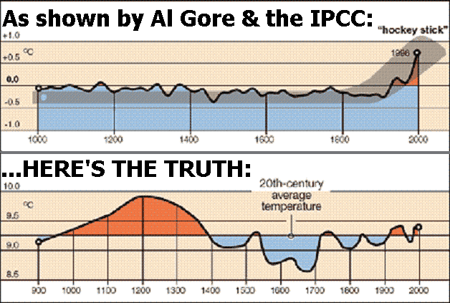
May 2019: Ex-UVA Professor Dr Michael Mann Loses Defamation Lawsuit vs. Canadian Climatologist, Dr Tim Ball
In 2003 a Canadian study showed the “hockey stick” curve “…an artefact of poor data handling, obsolete data, and incorrect calculation of principal components.” When the data was corrected it showed a warm period in the 15th Century that exceed warmth of the 20th Century
Mann’s hockey stick was used by IPCC and others to prove man-made global warming
Mann refused to produce the documents in court that would have helped to show whether Ball’s statement about him: “he belongs in the state pen”–was true or false

Slide 8
Albemarle County Must Be Smarter Than Google Engineers
A research effort by Google corporation to make renewable energy viable has been a complete failure:
“We felt that with steady improvements to today’s renewable energy technologies, our society could stave off catastrophic climate change. We now know that to be a false hope …
Renewable energy technologies simply won’t work;”
http://spectrum.ieee.org/energy/renewables/what-it-would-really-take-to-reverse-climate-change

Slide 9

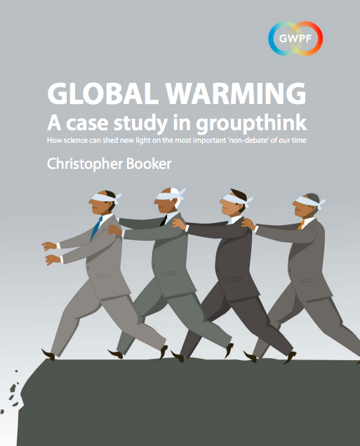
Cognitive Dissonance Blots Out Rational Thought
1956
Belief in Space Aliens Who Failed to Arrive as Predicted
2019
Belief That Manmade CO2 Alone Determines the Global Climate

Slide 10
Albemarle County Pledge 2019
Folly:
“to achieve net-zero emissions by 2050. The IPCC recommendation meets the intent of the Paris Agreement goal of keeping average global temperature rise within 1.5 degrees Celsius”
Fact:
There is no scientific proof linking man-made emissions to a specific change in climate; the human contribution is dwarfed by natural events
Fact:
Shutting down all of Virginia greenhouse gas emissions would save miniscule 0.0016 C by 2050
Future:
What will the cost to Albemarle taxpayers be for achieving the unachievable?
Who will profit from this project?

