Slide 1
Science, Not Scare Stories
Documented Facts vs. Mass Hysteria and Political Dogmatism
October 2, 2019
BOS Albemarle County, VA
Charles G. Battig, M.S.,M.D.
Virginia Scientists and Engineers for Energy and Environment
CO2 Coalition

Slide 2

Current Climate Change Hysteria Precedents
Charles MacKay’s Book 1841
Tulipomania
Witch Mania and Burning
Love of the Marvelous and Disbelief of the True…

Slide 3
U. N. Officials State That The Climate Crisis Has Nothing To Do With The Climate, and Everything To Do With Global Economic Power
"One has to free oneself from the illusion that international climate policy is environmental policy. This has almost nothing to do with the environmental policy anymore“ “We redistribute de facto the world's wealth by climate policy," said Edenhofer. (2010)
From 2004-2008, Ottmar Edenhofer was a lead author for the Fourth Assessment Report of the Intergovernmental Panel on Climate Change (IPCC)
"This is probably the most difficult task we have ever given ourselves, which is to intentionally transform the economic development model, for the first time in human history.“
Christiana Figueres, the Executive Secretary of the United Nations Framework Convention on Climate Change (UNFCCC),

Slide 4
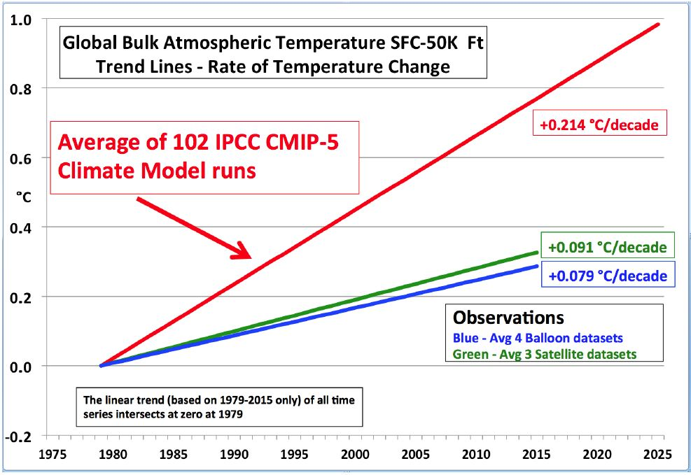
Climate Crisis Hysteria Based on False Claims
Climate Computers Produce What Programmers Want
UN IPCC Climate Computer Predictions Fail the Actual Observations

Slide 5
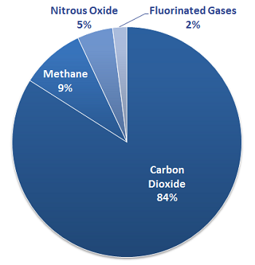
Greenhouse Gases
Science Facts vs. School Indoctrination
Science: Number One Greenhouse Gas is Water Vapor
https://www.britannica.com/science/greenhouse-gas M.Mann
What Your Kids Are Taught
https://study.com/academy/lesson/what-are-greenhouse-gases-lesson-for-kids.html
“Water Vapor is the most potent greenhouse gas in the Earth's atmosphere”
Water vapor constitutes Earth's most significant greenhouse gas, accounting for about 60 to 95% of Earth's greenhouse effect

Slide 6
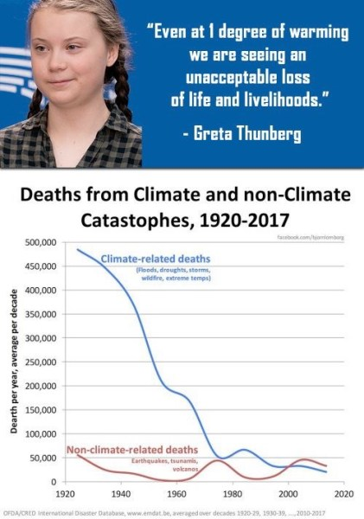
Child Exploitation On Stage From A Swedish Family Of Theatrical Professionals Driving Your Children To Needless Anxiety
“The Greta phenomenon has also involved green lobbyists, PR hustlers, eco-academics and a think tank founded by a wealthy former minister in Sweden's Social Democratic government with links to the country's energy companies. These companies are preparing for the biggest bonanza of government contracts in history” NYT Aug. 18 2019
Despite CO2 levels rising from 260 ppm to 410 ppm, the country where she resides has continued to record nearly the coldest temperatures of the last 9000 years.

Slide 7
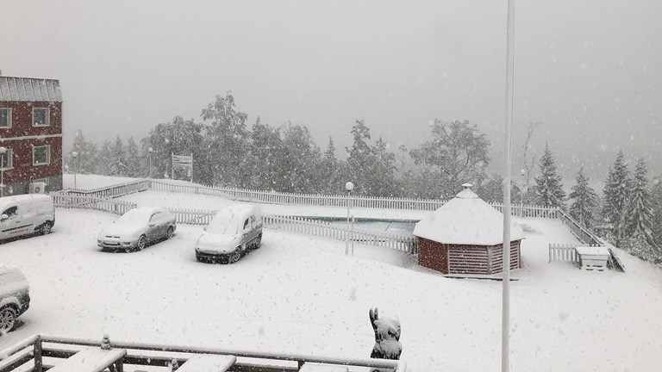
No Greta, Sweden and Scandinavia are Not Burning Up
Yes, Climate Change is Normal and Eternal
Winter arrives early in Värmland Sweden, September 17, 2019:
"I have been here for 20 years and it has never snowed this early," Dan Nordström at Långberget told media
Also in Norway: Winter came early over the weekend, with stormy weather dumping up to 20 centimeters of snow in some areas of the mountains while also wreaking havoc over wide areas of Vestlandet

Slide 8
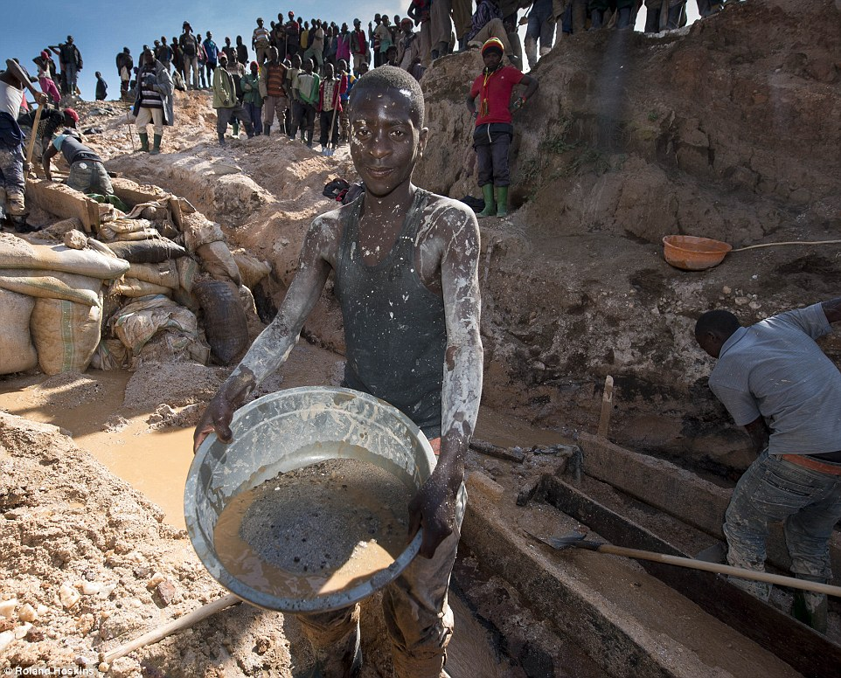
Concern for Children, Yes
What About These African Kids Mining Rare Earth Minerals And Their Mothers? Will They Even Live To 2050 ?
“The glamourous shop displays and marketing of state of the art technologies are a stark contrast to the children carrying bags of rocks, and miners in narrow manmade tunnels risking permanent lung damage.”
Mark Dummett, Business & Human Rights Researcher at Amnesty International

Slide 9
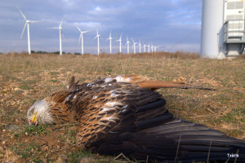
Wind Turbines Slaughter Birds and Lead To Loss of Natural Ecological Balance
Incr
Red kite agonizing under wind turbine, Spain.
Courtesy of association of ecologists GURELUR, Navarre
“Wind turbines kill an estimated 140,000 to 328,000 birds each year in North America, making it the most threatening form of green energy.” Audubon Society
A conservative estimate is that at least 4 million bats have been killed by wind turbines since 2012. Bats are our primary natural defence in keeping mosquito and crop-damaging insect populations in check. One bat can eat between 500 and 1,000 mosquitoes and other insects in just one hour, or about 6,000 per night…

Slide 10
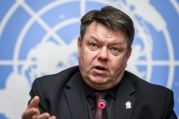
Chief of U.N. World Meteorological Organization (WMO)Castigates Climate Alarmists
Petteri Taalas, the secretary-general of the WMO
The media in his country are creating additional anxiety. He disagrees with doomsday climate extremists who call for radical action to prevent a purported apocalypse.
“Climate experts have been attacked…they claim that we should be much more radical. They (attackers) are doomsters and extremists; they make threats.”
“The IPCC reports have been read in a similar way to the Bible: you try to find certain pieces or sections from which you try to justify your extreme views. This resembles religious extremism,”
“The latest idea is that children are a negative thing. I am worried for young mothers, who are already under much pressure. This will only add to their burden,”

Slide 11
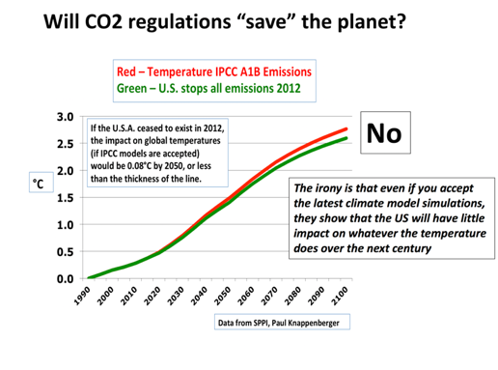
Carbon Dioxide Has Little Impact On Temperature
Can the BOS Tell The Taxpayers How Much County Proposals Will Change The Climate? How Much They Will Cost?
Total Elimination of U.S. CO2
Total Elimination of All Virginia CO2
No Fossil Fuels
Temperature saving by 2050
0.0016 C

Slide 12
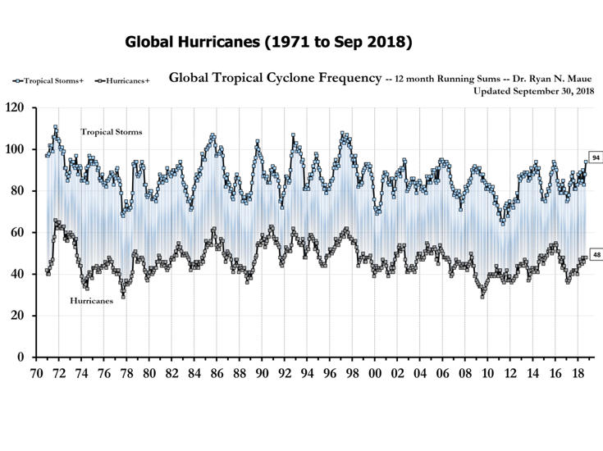
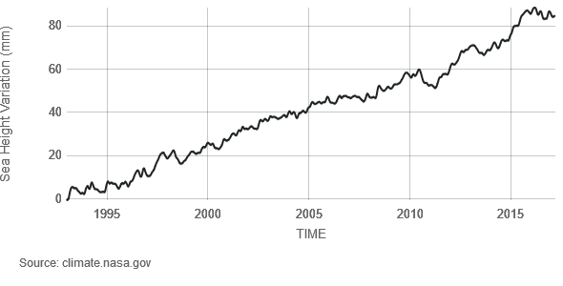
Where’s the Beef? Where’s the Climate Crisis?
No Upward trend in Hurricanes or Tropical Storms
No Change in Steady Rate of Sea Rise of 7-10 Inches per 100 years

Slide 13
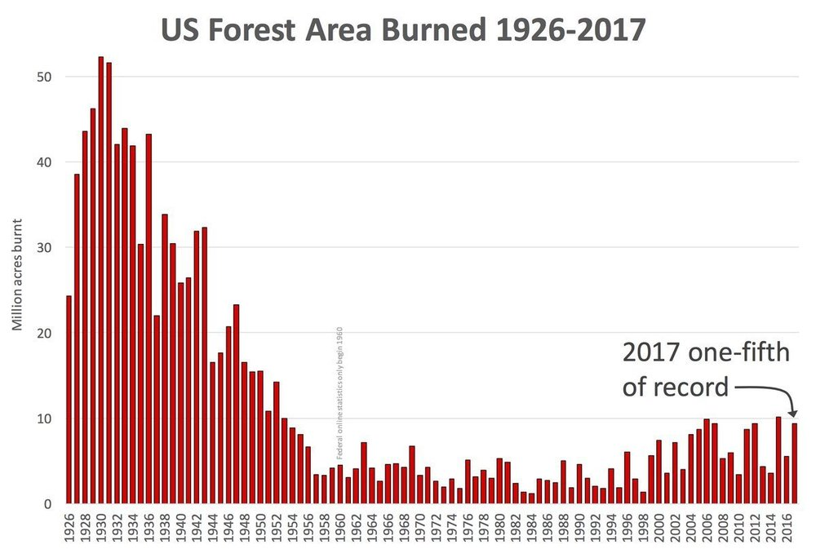
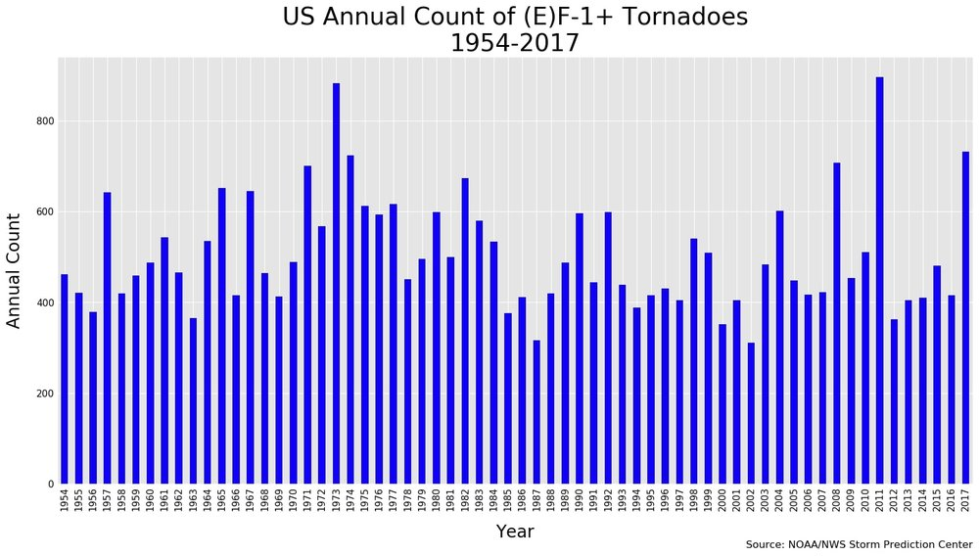
No, Forest fires and Tornadoes Are Not Getting Worse…Where Is the Crisis?
More Fires When CO2 Was Much Less
No Increase or Upward trend

Slide 14
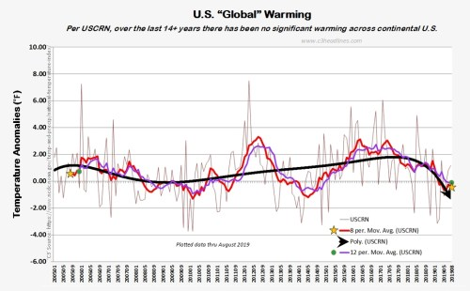
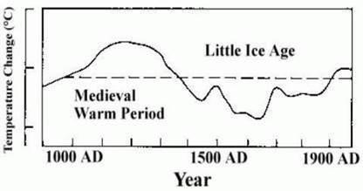
Global Temperatures, Present and Past
No Significant U. S. Warming Past 14+ Years
Source: Figure 7c from the IPCC FAR

Slide 15
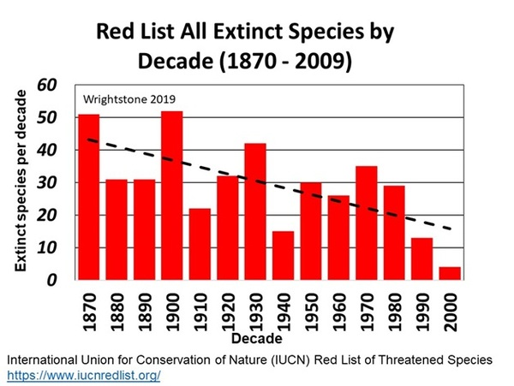
Species Extinctions Down, Not Up
Real Extinctions, Not Computer Predictions

Slide 16
Worried About Your Carbon Footprint?
Over all, 1,600 coal plants are planned or under construction in 62 countries, according to Urgewald’s tally, which uses data from the Global Coal Plant Tracker portal. The new plants would expand the world’s coal-fired power capacity by 43 percent.
The fleet of new coal plants would make it virtually impossible to meet the goals set in the Paris climate accord, which aims to keep the increase in global temperatures from preindustrial levels below 3.6 degrees Fahrenheit.
A version of this article appears in print on July 2, 2017, Section A, Page 10 of the New York edition with the headline: As Beijing Joins Climate Fight, Chinese Companies Build Coal Plants.

Slide 17
Spend Albemarle Taxpayer Monies On Local Real Needs
Education
Affordability
Housing
Accommodate Growth
Attract Viable Businesses

