Slide 1
Perpetual Climate Panic Failures Fuel Albemarle County’s U.N. ICLEI Embrace
October 16, 2019
BOS Albemarle County, VA
Charles G. Battig, M.S.,M.D.
Virginia Scientists and Engineers for Energy and Environment

Slide 2
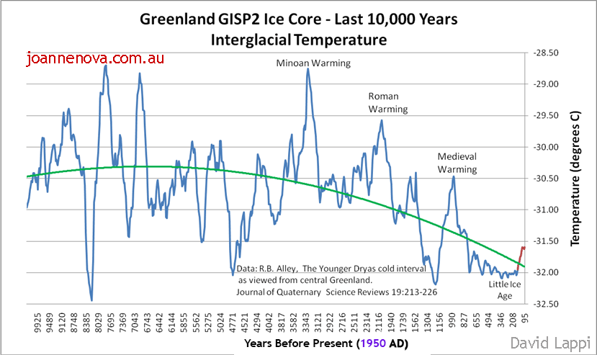
Current Climate Hysteria Is Focused on the Red Blip At Lower Right Graph

Slide 3
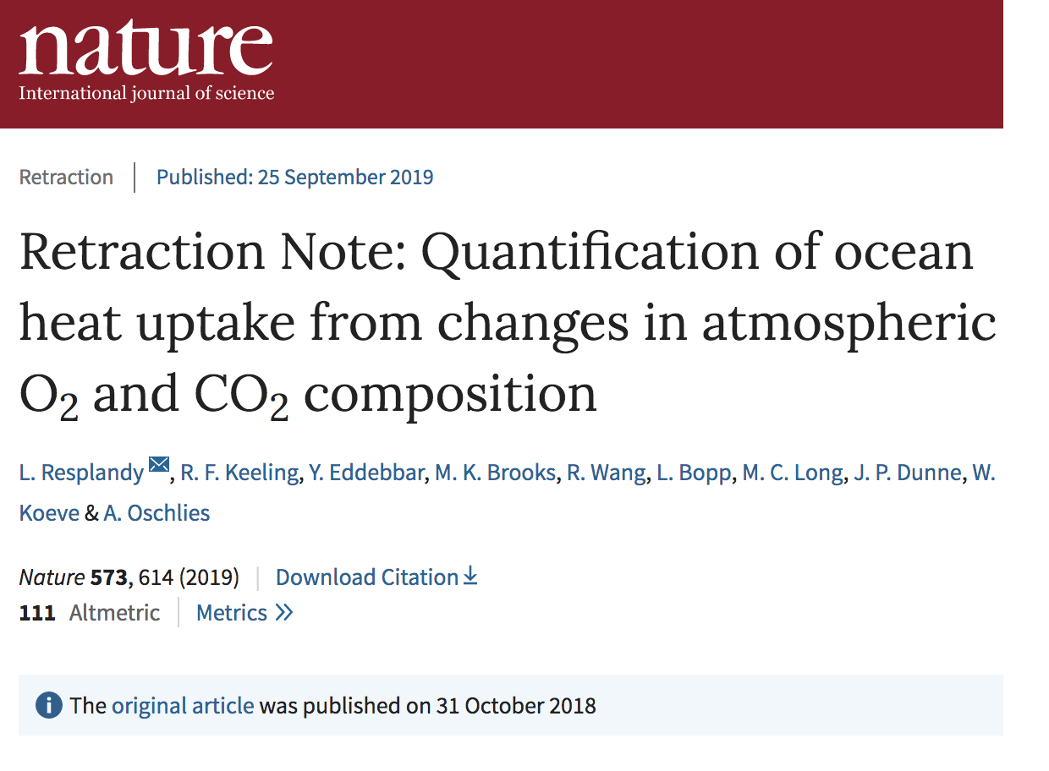
“Global Warming Never Was and Never Will Be a Serious Problem…”
“””simply isn’t supported by any direct evidence”
A major scientific paper, which claimed to have found rapid warming in the oceans as a result of manmade global warming, has been withdrawn
Professor Nir Shaviv, the chairman of the Racah Institute of Physics at the Hebrew University of Jerusalem: "The West would then realize that global warming never was and never will be a serious problem...To begin with, the story we hear in the media, that most 20th-century warming is anthropogenic, that the climate is very sensitive to changes in CO2, and that future warming will, therefore, be large and will happen very soon, simply isn’t supported by any direct evidence, only a shaky line of circular reasoning."

Slide 4
From: Albemarle County: AGENDA DATE: 9/18/2019 File #: 19-464, Version: 1
TITLE: Climate Action Planning Phase 1 Update
“September 6, 2017 the Board adopted a Resolution”:
“Reaffirm Commitment to Support Local Action to Reduce Climate Pollution”…
  This is a non-scientific, nonsense term with no scientific credibility, a political invention at best.
“…to adopt the Intergovernmental Panel on Climate Change (IPCC) recommendation of reducing community-wide greenhouse gasses 45% by 2030 and to achieve net-zero emissions by 2050. The IPCC recommendation meets the intent of the Paris Agreement goal of keeping average global temperature rise within 1.5 degrees Celsius”…
  The IPCC labeled Global Climate “a coupled non-linear chaotic system”, and stated that “long-term prediction of future climate states is not possible.” (IPCC 3rd Assessment Report, 2001). The U.N. has itself documented the impossibility of making such temperature predictions. The IPCC is not a climate research entity; it is a political body targeting human energy activities. Why does the county blindly accept this foreign body to set local goals? Where is the proof that reducing local green-house gases will produce any change in the climate?

Slide 5
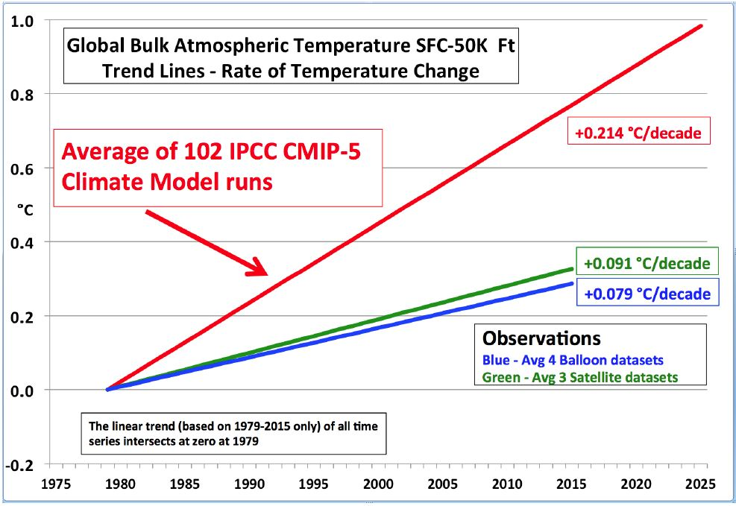
U.N. IPCC Climate Computers Predicted 3X The Actual Warming Over a Fifty Year Period
Albemarle County Pledges to Follow U.N. Anyway!

Slide 6
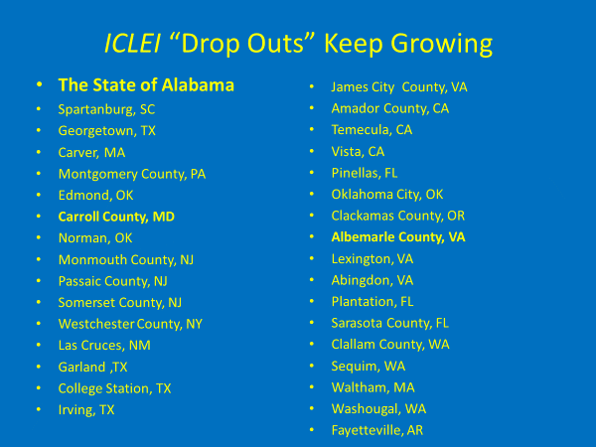
Albemarle County Now Wants to Rejoin ICLEI After Dropping Out With Many Others in 2011;
ICLEI is the Handmaiden of the U.N. Agenda 21 (1992)
ICLEI (International Council for Local Environmental Initiatives)
“Sustainability” is a U.N. political creation of the Brundtland Report 1987
It combines vagueness, fosters unaccountable bureaucratic control, ignores future scientific progress, and offers no recognized end-point of success
Ultimate aim is to justify bureaucratic control of all personal property rights “to save the environment”

Slide 7
Is Albemarle County Advocating Building More Nuclear Plants to Achieve “Carbon Neutrality”?
Roger A. Pielke Jr. (environmental studies program at the University of Colorado) ran the numbers on proposals to achieve carbon neutrality
To reach net-zero emissions by 2030, or in 3,746 days from now, would mean deploying about four nuclear power plants per day globally, and “for the United States, the deployment of a new nuclear plant about every other day.”

Slide 8
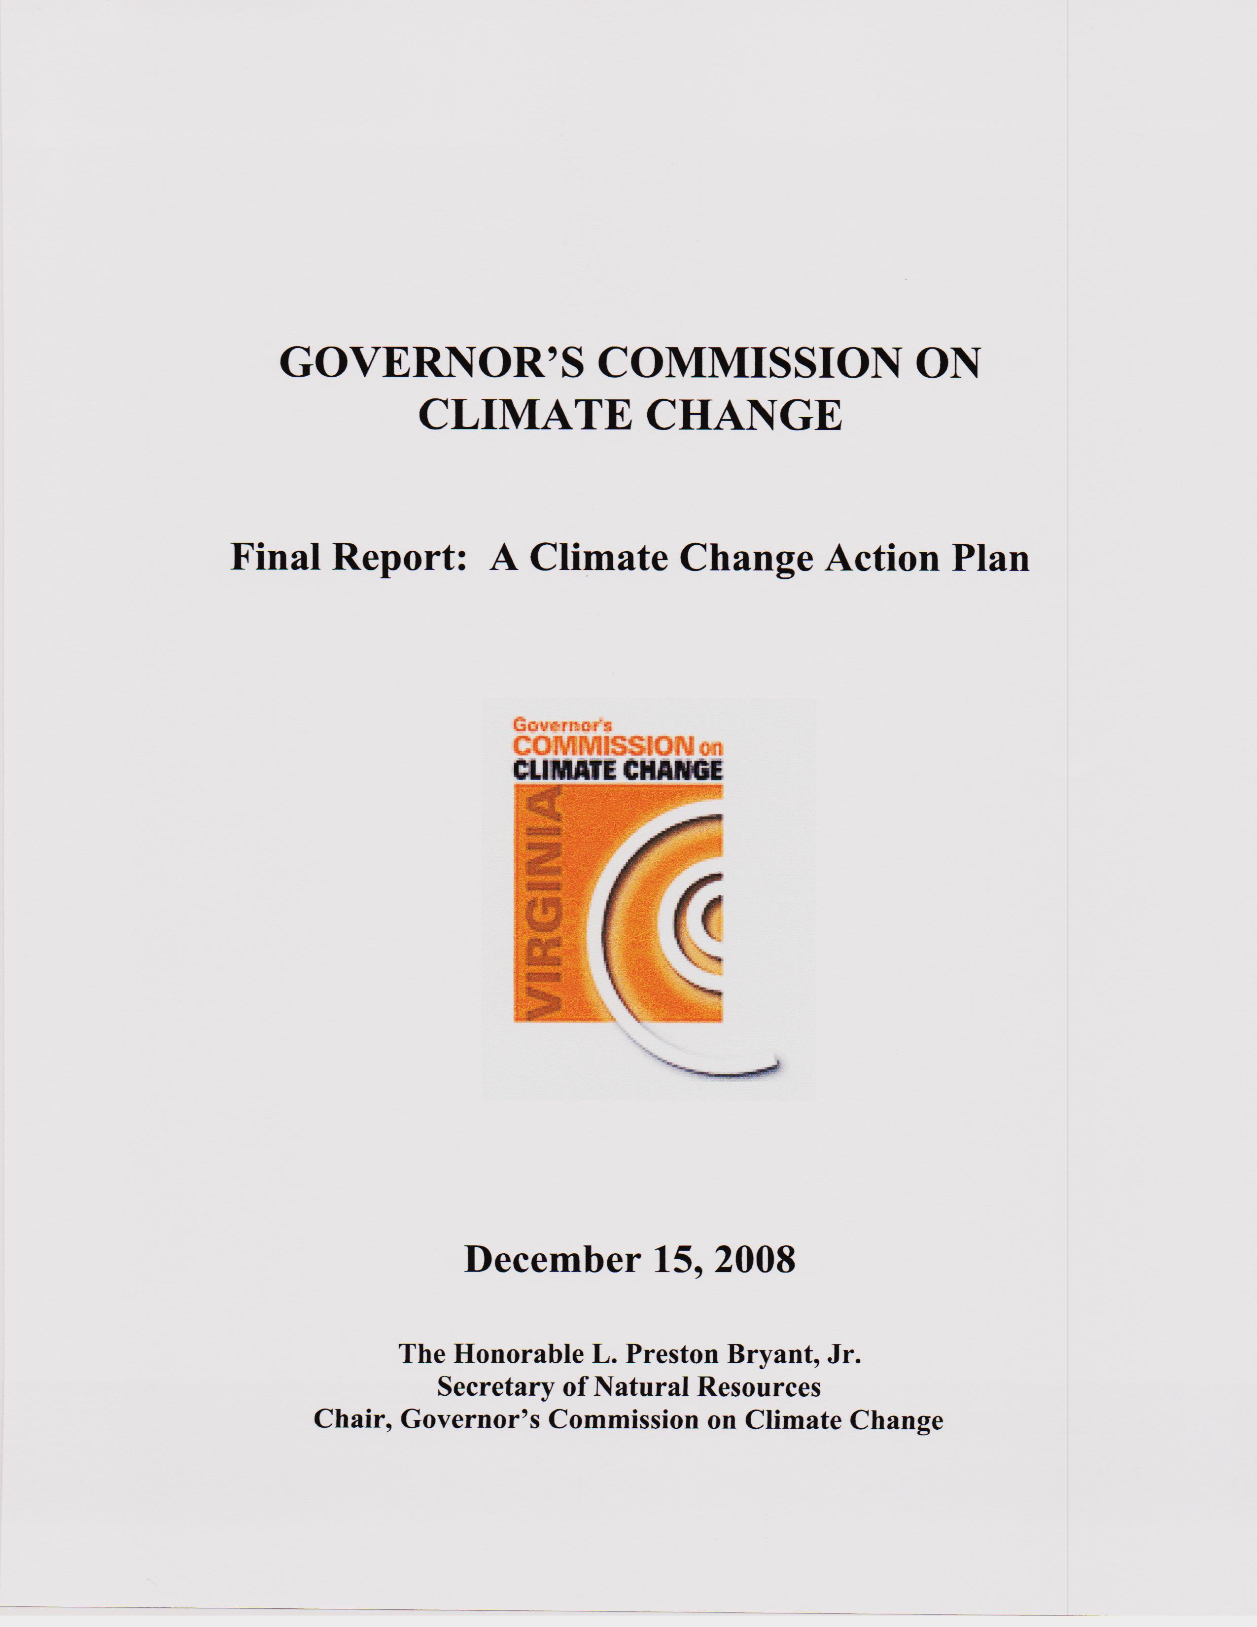
Gov. T. Kaine Climate Commission(2008)
Goal to Reduce GHG 30% By 2025
Albemarle County 2019 Reinventing the Wheel?

Slide 9
Is This the County Plan, and Why? It Will Have No Measurable Effect on the Climate
Green virtue, vague platitudes: “good for the environment”
No county official has provided any scientific evidence that a specific change in the climate will result from a specific county climate plan
No county official has put a taxpayer dollar cost for a specified change in the climate; if you cannot first measure it, then this is a misuse of county taxpayer funds to claim to achieve the unachievable
Renewable energy sources such as free wind and free solar increase consumer energy costs; they are always more costly when all associated costs are included, and are often more damaging to the environment and to human health
Needlessly making energy more expensive and then offering rebates or more expensive appliances to save energy costs is a sham, but a money maker for the promoters…enjoying two hour dishwasher cycles?

Slide 10
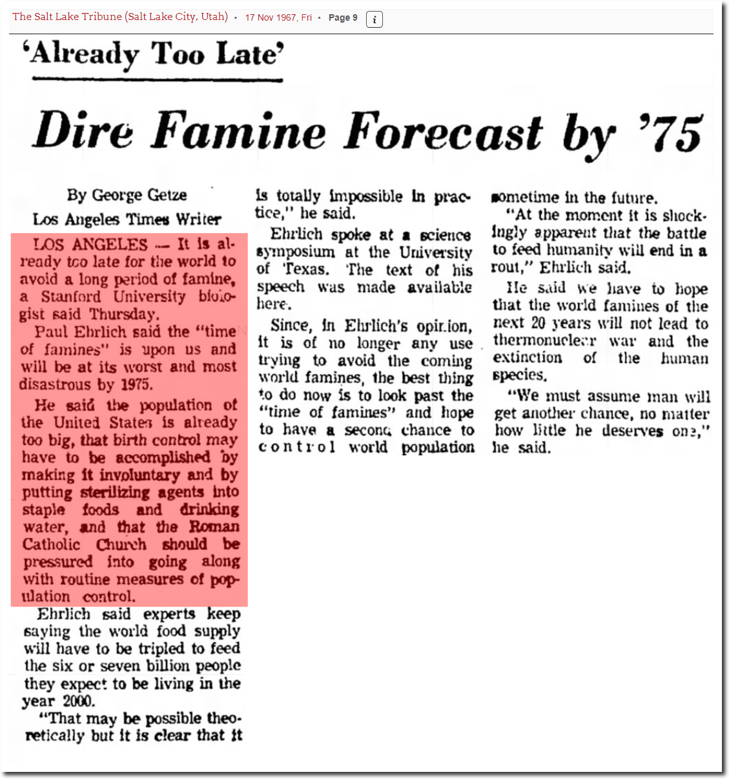
Paul Ehrlich Forecast November 17, 1967;
Sustainable Population Advocates’ Belief Unchanged?

Slide 11
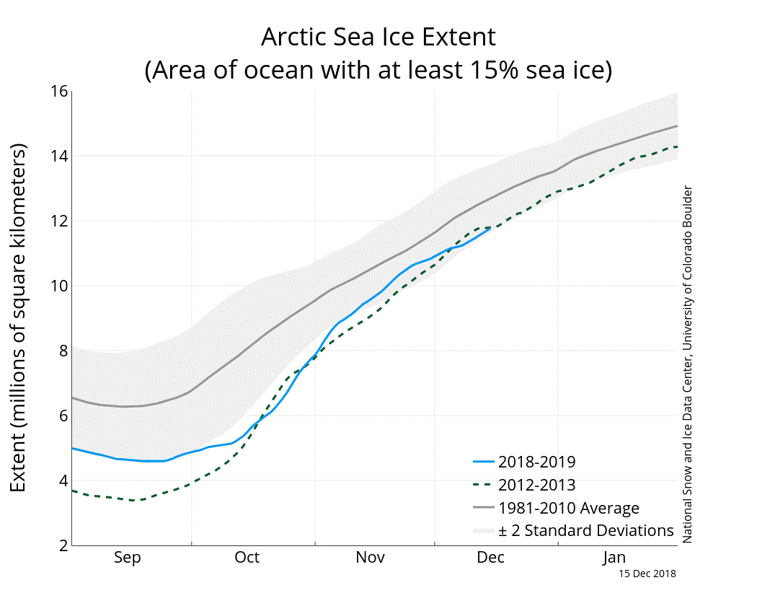
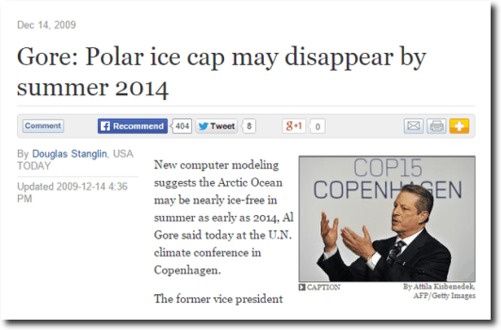
Another Al Gore Climate Prediction (2009) Fails, and Continues to Fail

Slide 12
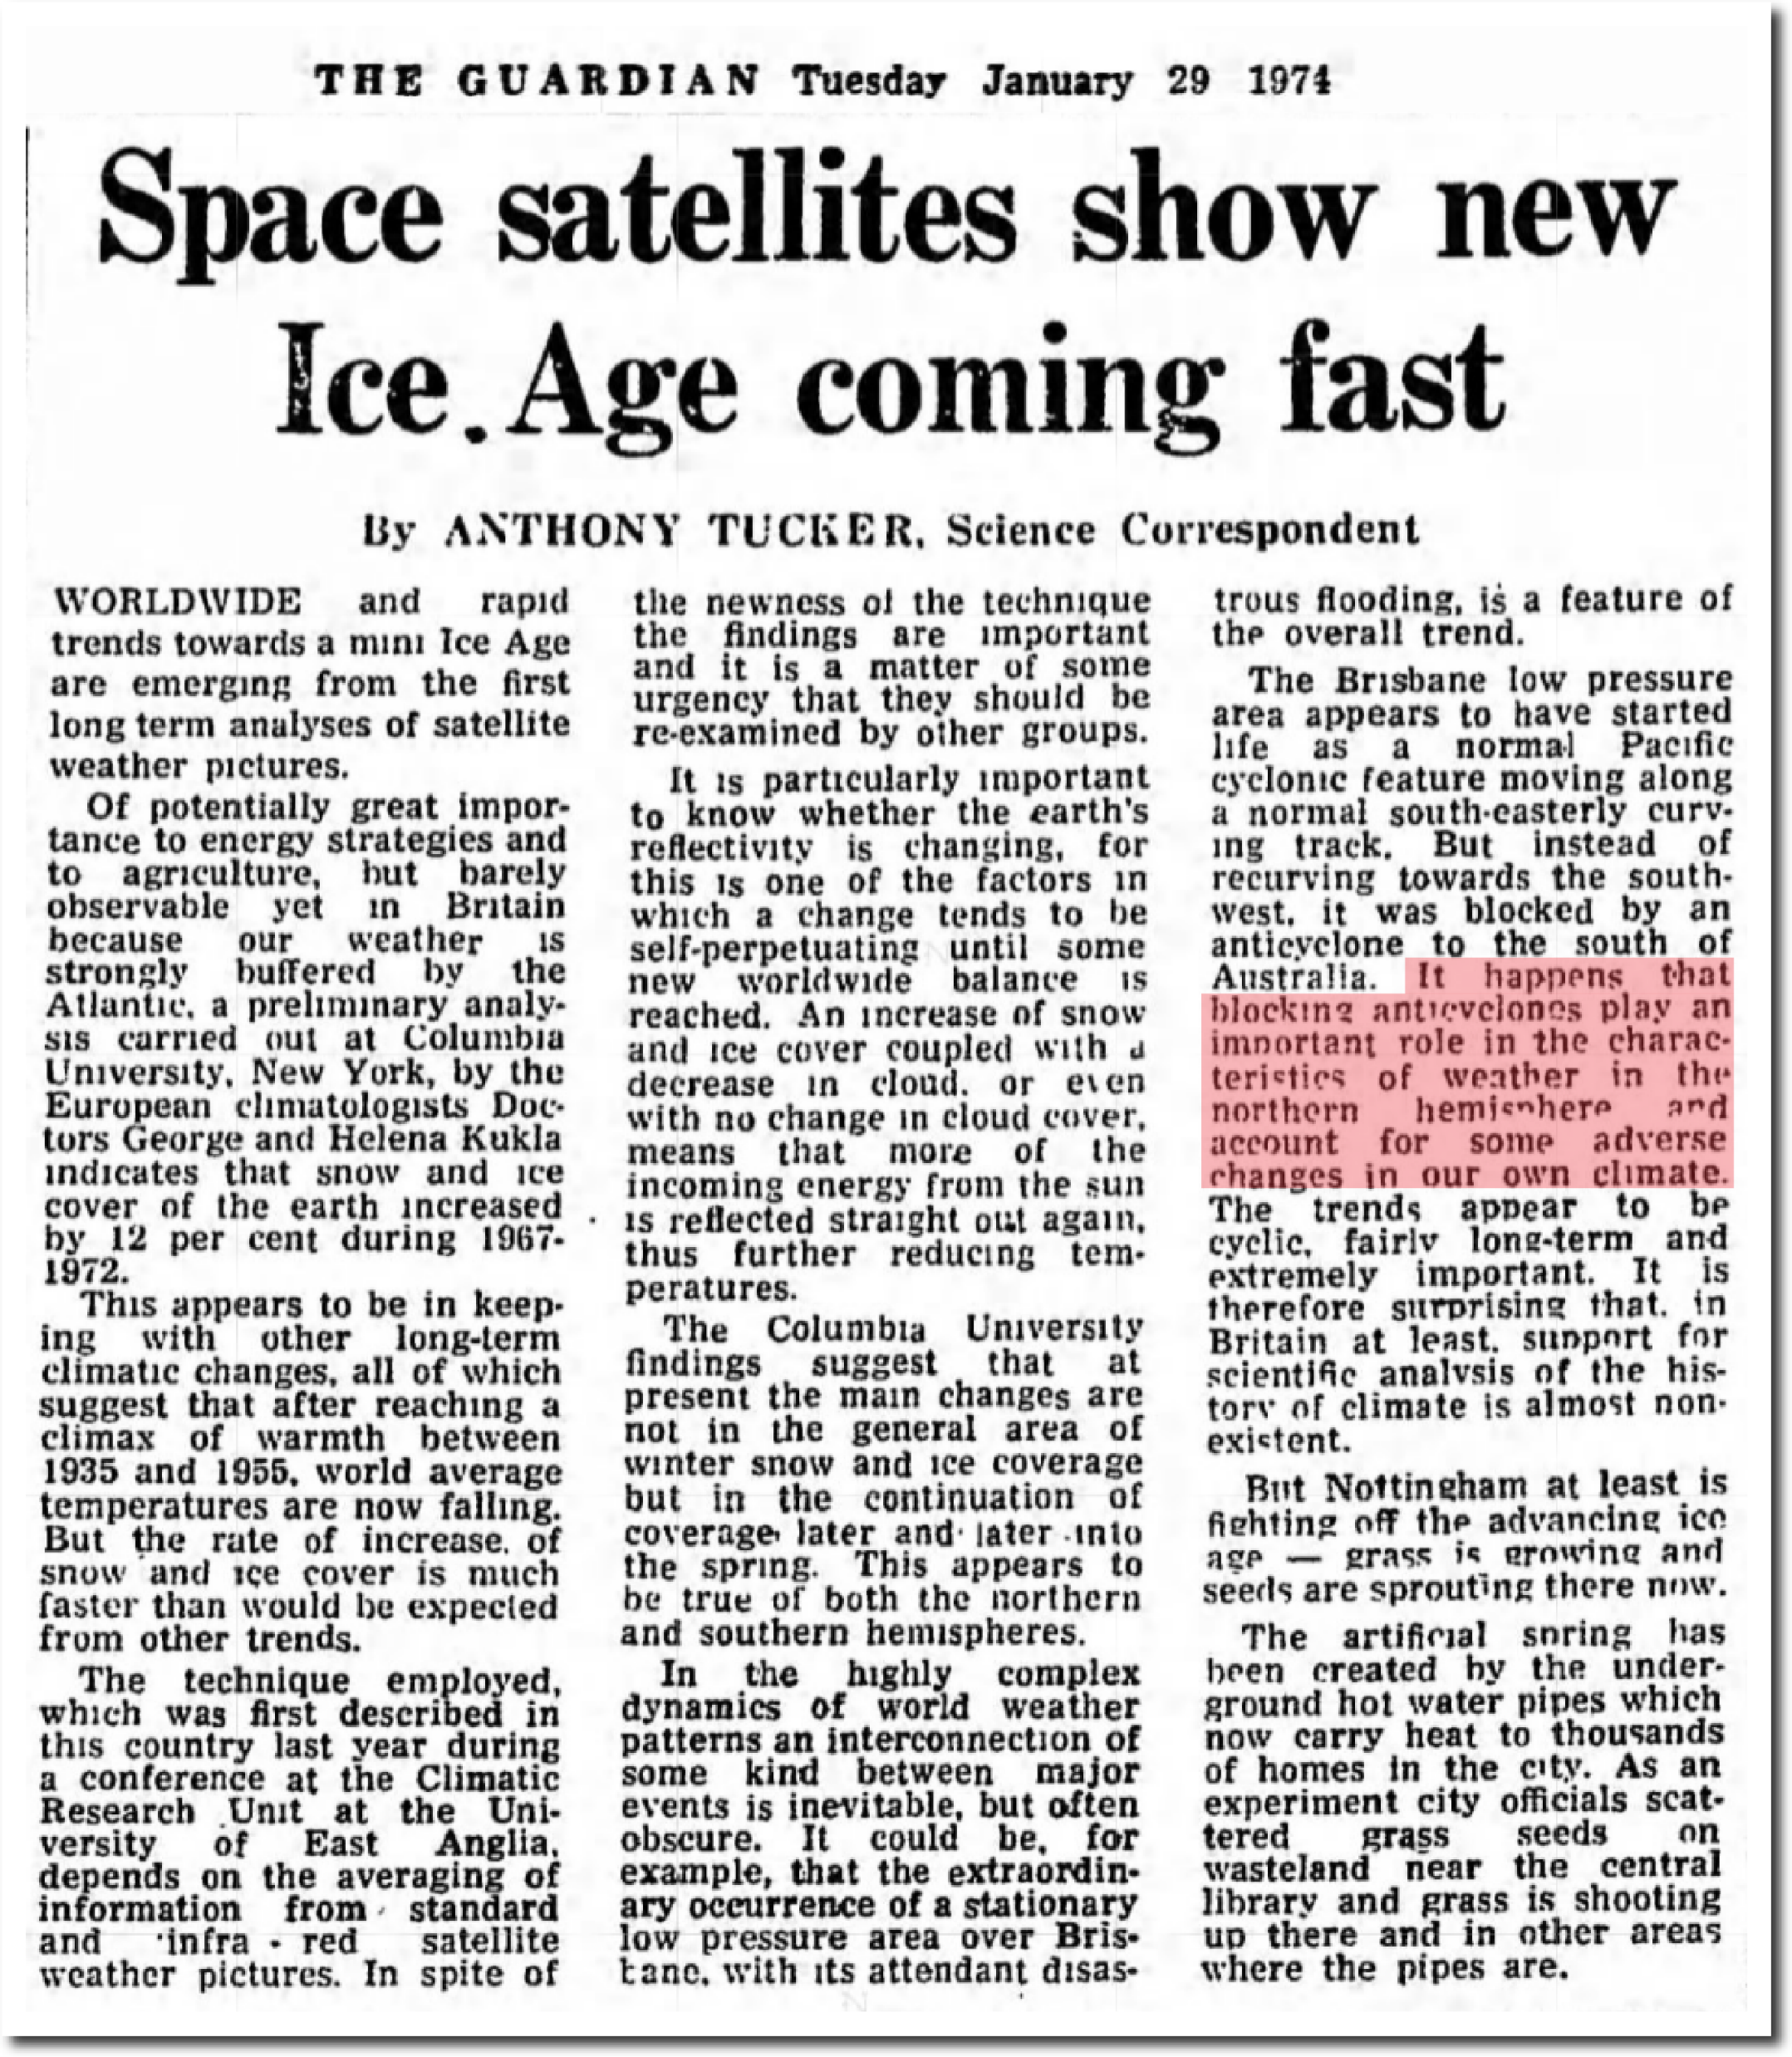
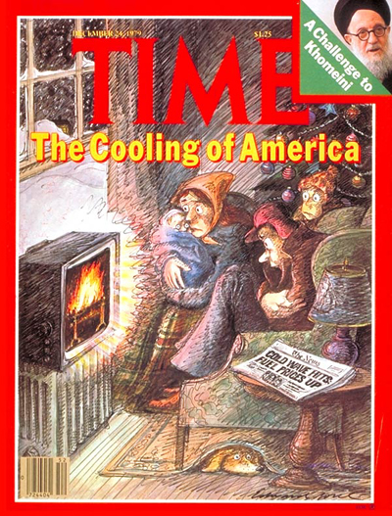
New Ice Age Almost Here in 1974, 1979…
Still Waiting
January 1974
December 1979

Slide 13
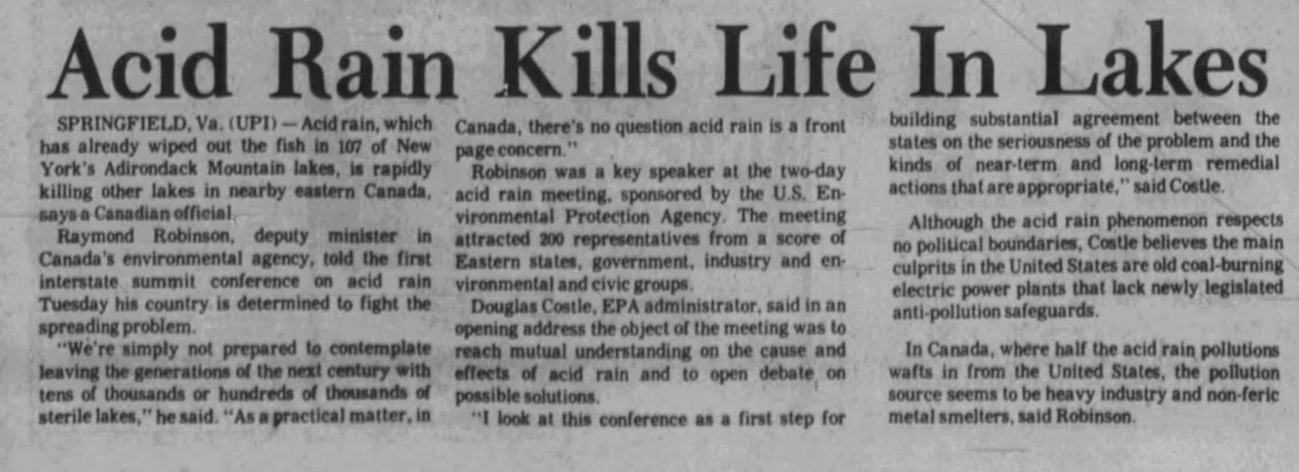
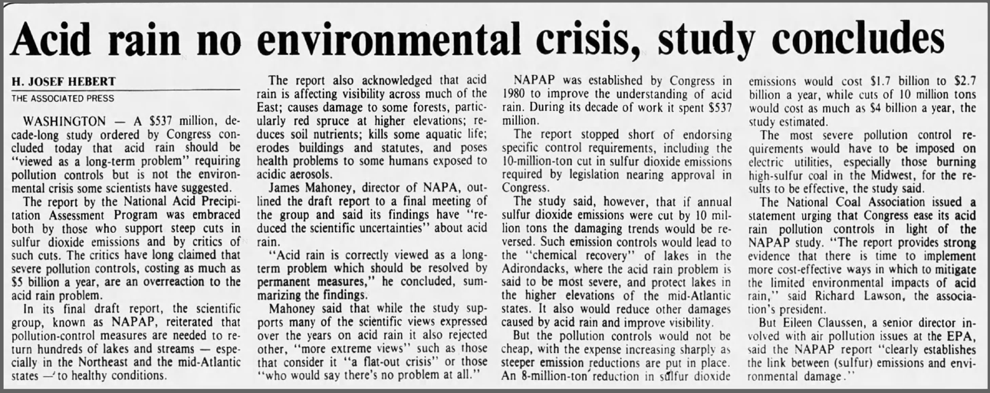
Ten Years and $537 Million Later,
Acid Rain Not A problem

Slide 14
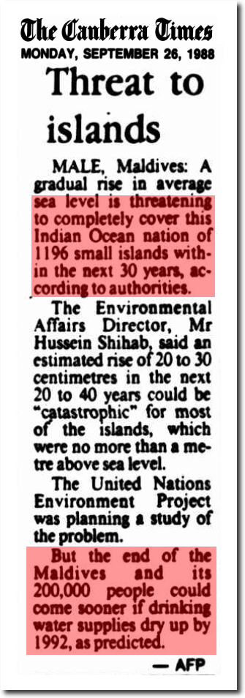
Thirty Years After 1988 Predicting Their End, Maldives Still There Welcoming Tourists
19SEP 2019Influencers from USA Arrive In Maldives to Promote Tourism
Posted By MMPRCUncategorized0 COMMENTS
Maldives Marketing and Public Relation Corporation (MMPRC) welcomed influencers from USA to Maldives for a familiarization trip on 13 September 2019. This is the thirteenth familiarization trip conducted by the corporation for various markets this year. The influencers will spend their time in Diamonds Athuruga, LUX* South Ari Atoll and in Reethi Faru Resort during […]

Slide 15
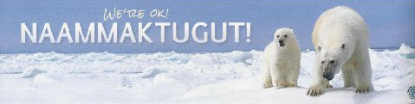
Data published since 2017 show that global polar bear numbers have continued to increase slightly since 2005, despite the fact that summer sea ice in 2018 was again at a low level not expected until mid-century: the predicted 67% decline in polar bear numbers did not occur.*
National Geographic received such a profound backlash from its widely viewed ‘this is what climate change looks like’ starving polar bear video, released in late 2017, that in 2018 it made a formal public apology for spreading misinformation.*
Canadian biologist Dr. Mitchell Taylor, one of the foremost authorities on polar bears, says: "We're seeing an increase in bears that's really unprecedented, and in places where we're seeing a decrease in the population it's from hunting, not from climate change."
Bumper sticker from Cambridge Bay, Nunavut, courtesy Joe Prins. *Zoologist Dr Susan Crockford
2018 State of the Polar Bear Report report
.

