Slide 1
Some Critical Comments
Regarding
The County Comprehensive Plan Draft
Skepticism is the first step to Truth – D. Diderot
Albemarle County BOS
March 12, 2014 presentation
by
Charles Battig, MD
VA-Scientists and Engineers for Energy and Environment

Slide 2
Albemarle County Comprehensive Plan Proposal Violates VA State Code VA Code 15.2-2223
Enabling VA State Code VA Code 15.2-2223 specifies that comprehensive plans are to be “general in nature.” There are to be advisory.
On this basis alone the proposed plan deserves to be rejected as it imposes micromanagement at every level and in every aspect of County citizens’ lives.
The Plan is a fabrication of pre-determined, intrusive solutions to everyday activities.

Slide 3
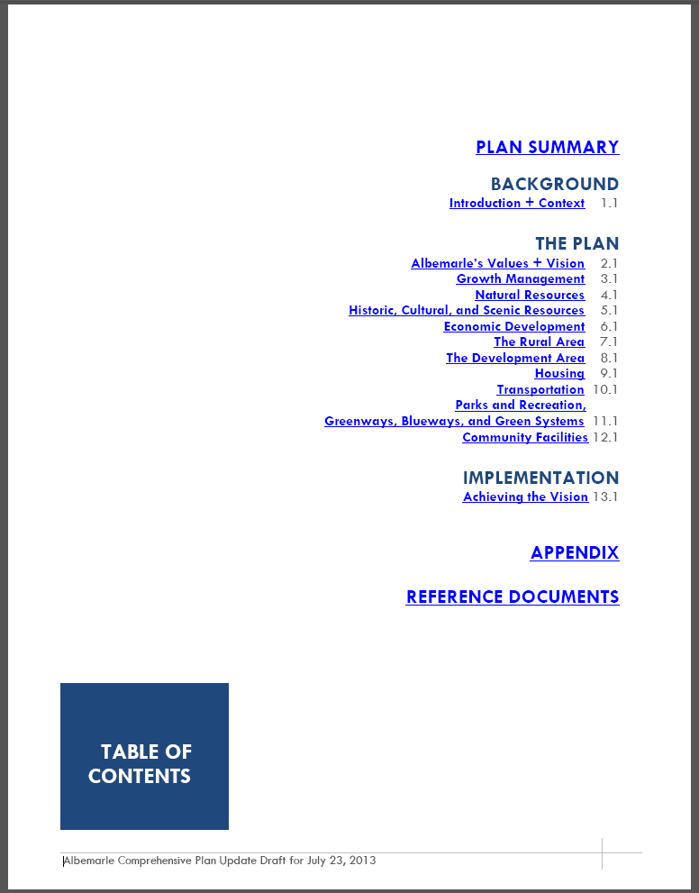
General in Nature, Advisory?
“Plan Summary” alone is
55 pages
“Background,” “The Plan,” and “Implementation”
comprise 13 chapters and over 400 pages
Have all of you read all of it?
b

Slide 4
Planning: Wikipedia definition
“Planning is a key characteristic of centralized, communist economies, and one plan established for the entire country normally contains detailed economic development guidelines for all its regions”
The Albemarle County Comprehensive Plan Draft Comes Close,
Much Like Obamacare

Slide 5
“Development Areas”
Objective 4: Achieve high quality development through application of the Neighborhood Model Principles.
A Micro-Management Wish-List By “Planners Gone Wild” Imposing The APA And County Staff Vision
Strategy 4b: Promote block development rather than long cul-de-sacs and provide guidance to developers on ways to create blocks and streetscape with Albemarle County’s topography.
Strategy 4c: Continue to designate and fund construction of crosswalks for sidewalks.
Strategy 4d: Conduct a study on ways in which streetlights can enhance pedestrian safety in the Development Areas.
Strategy 4e: Continue to approve mixed-use developments that are in keeping with the Neighborhood Model and Master Plans.
Strategy 4f: Continue to promote centers as focal points for neighborhoods and places for civic engagement.
Strategy 4g: Through Master Plans and rezoning approvals, ensure that all Development Areas provide for variety of housing types and levels of affordability.
Strategy 4h: Encourage builders to make affordable housing units visually indistinguishable on the exterior from other units.
Strategy 4i: Through rezoning and special use permit decisions, ensure that affordable housing units are dispersed throughout the Development Areas rather than built in enclaves.
Strategy 4j: Continue to require that streets are interconnected in the Development Areas; ensure that exceptions occur rarely and not routinely.
Strategy 4k: Provide for multi-modal transportation opportunities in new development and encourage the building of complete streets.
Strategy 4l: Continue to develop and maintain public parkland shown on Master Plans. Continue to require recreational amenities in residential developments.
Strategy 4m: Continue to promote appropriate scale, massing, and enclosure with new development proposals.
Strategy 4n: Continue to work with developers to design and build projects which relegate parking to the side or rear of sites and which results in the fronts of building facing the street.
Strategy 4o: Promote redevelopment as a way to improve, and not expand the Development Areas.
Strategy 4p: Encourage developers to design buildings which fit into the terrain rather than flattening the land for trademark buildings.
Strategy 4q: Require that re-graded slopes result in smooth rather than abrupt or steep grades that are difficult to vegetate and maintain.

Slide 6
“Vision and Values
Goals, Objectives, and Strategies”
“Preservation and enhancement…, along with preserving the individual rights of citizens, is key to future prosperity in the County…”
Lip service…Most Of The Comp Plan Draft Does Just The Opposite

Slide 7
“Rural Area”
“Strategy 8a: Inform existing property owners, realtors, and prospective property owners in the Rural Area that the rural Area is not intended for residential development.”
There goes “preserving individual rights of citizens.” Your rights are preserved; you just cannot exercise them.
“Instead, emphasis is placed on stewardship of the land, retaining agricultural and forestal activities, protecting natural resources, and maintaining unfragmented land to protect biodiversity.”
Bogus Biodiversity is substituted for constitutionally guaranteed private property rights

Slide 8
Chief Scientist Of The Nature Conservancy Contradicts Bogus Biodiversity Dogma
P. Karieva Chief Scientist and Director Breakthrough Journal Summer 2011
“…ecologists and conservationists have grossly overstated the fragility of nature, frequently arguing that once an ecosystem is altered, it is gone forever.
The trouble for conservation is that the data simply do not support the idea of a fragile nature at risk of collapse.”
Mandated Radical Environmentalism And Bogus Biodiversity Claims Are Not Necessary For Prudent Conservation

Slide 9
“Rural Area”
“Strategy 1d: Consider modifying the zoning regulations to help achieve Rural Area objectives without reducing residential development rights.”
Planners will just re-define “development rights” to a narrower range of choices
“Strategy 1g: Strengthen the Acquisition of Conservation Easements (ACE) Program by providing a stable dedicated funding source and staff resources for administering the program.”
Scarce County taxpayer monies are given the privileged-few who then enjoy a variety of generous tax write-offs and lower property taxes, by selling their private property rights. Then their County property tax burdens are passed on to everyone else, who get to pay twice.
Almost 20% of the County is now under ACE third party control; how much is enough?

Slide 10
“Economic Development”
“Strategy 2j: Monitor performance of the County’s Strategic Plan and the Comprehensive Plan with relation to education, housing, day, care, transportation and others, to address barriers experienced by the local work force, particularly those with the greatest needs.”
The majority of the local work force voting in the Livability Project chose to live in the rural area, because they found living costs were less there, and a better value.
More regulations = More expensive cost of living
Smart Growth=Less choice and more expensive housing

Slide 11
“Growth Management”
“Only approve new development proposals in the Rural Area if those legislative requests are supported by Rural Area goals, objectives, and strategies.”
Who crafted these “Rural Area goals”? What happened to “preserving the individual rights of citizens?” The Rural area citizens are however approved to be a source of property taxation.

Slide 12
“Community Facilities”
Strategy 10c: Continue to require reviews for compliance with the Comprehensive Plan for requests for gas line extensions to and through the Rural Area. Require compliance reviews with the Comprehensive Plan for requests for fiber optic extension to and through the Rural Area.
Planners’ bias against the Rural Area obtaining necessary energy and high-tech access? The Comp Plan as a tool of discrimination…

Slide 13
“Natural Resources”
“Strategy 2a: Help protect air quality by reducing the County's carbon footprint…”
Carbon footprint is political talk. How is it measured?
What air quality problem?

Slide 14
This Comp Plan Draft Deserves Line-By-Line Prudent Review
So-called public input multiple meetings dominated by special interest groups do not voice the concerns of the average working taxpayer
The BOS prior vote to Fast Track this overbearing document is their own “Midnight Vote” vote

